Slide 1
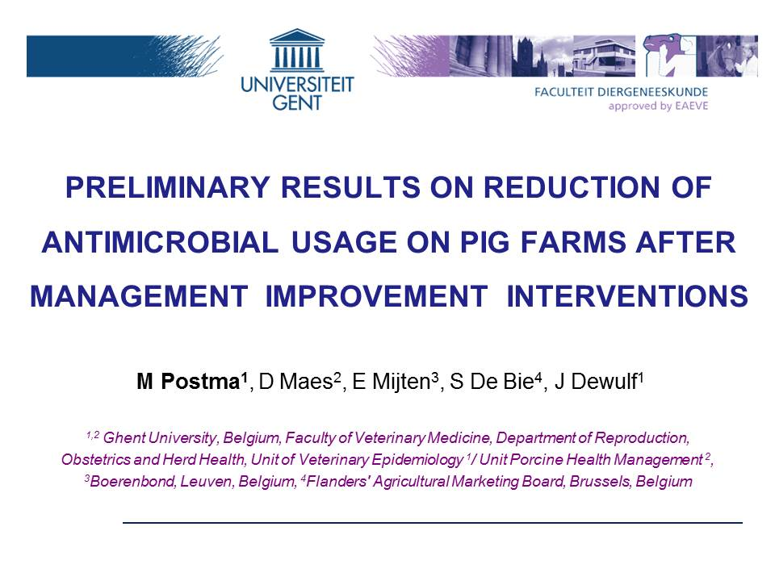
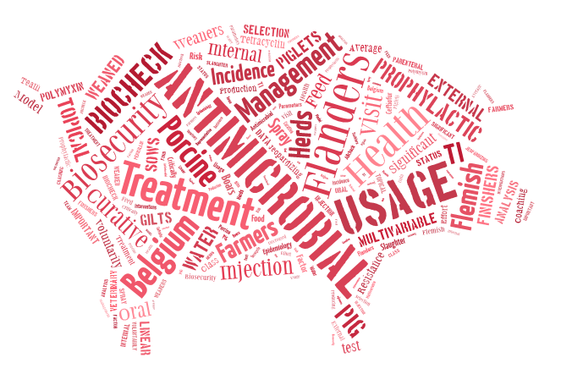
Antimicrobial use in
pig production in
different EU countries
& proven methods to reduce
Merel Postma DVM
Unit for Veterinary Epidemiology
Faculty of Veterinary Medicine, Ghent University, Belgium
IPHS – Mullingar Park Hotel, Co. Offaly – 12 April 2016

Slide 2
THE PROBLEM OF AMU AND AMR
Fase I:
Development of AMR
Fase II:
Selection of AMR
Fase III:
Persistence of AMR
Fase IV:
Reduction of AMR
2

Slide 3
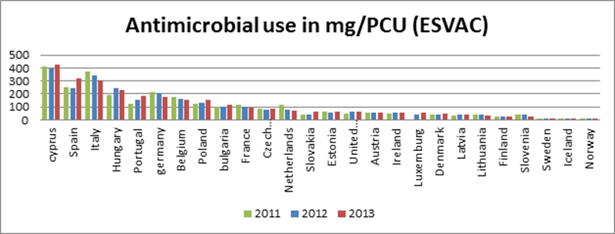
Use of antimicrobials
ESVAC 2015 (data 2013)

Slide 4
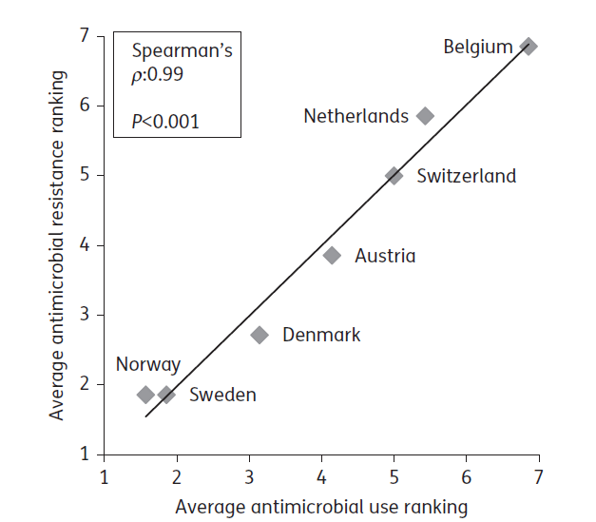
Link usage – resistance country level
Chantziaras et al., 2013

Slide 5
Using less antimicrobials results in less resistance

Slide 6
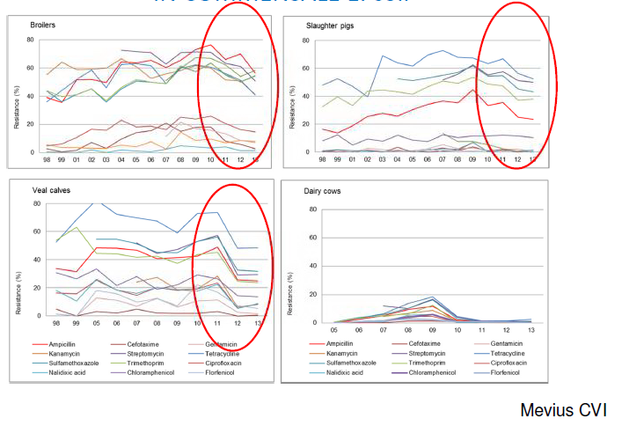
Relation with resistance
MARAN, NL
Reduction AMU → reduction in resistance levels E. coli

Slide 7
In pig production, less antimicrobials may also result in better production

Slide 8

Associations between biosecurity, herd characteristics, production parameters and antimicrobial usage in pig production in four EU countries

Slide 9
Working hypothesis
Antimicrobial usage in pig production
is associated with:
The herd biosecurity level
The herd characteristics
The herd sanitary status

Slide 10
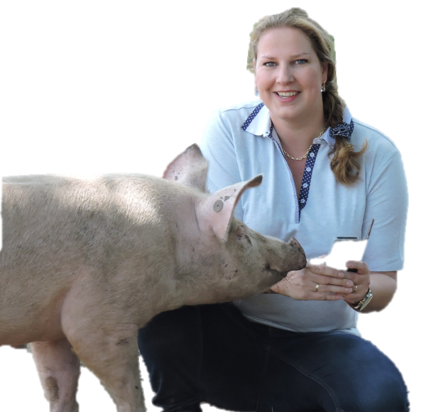
Study design
Multi country:
  Belgium = 47
  France = 60
  Germany = 60
  Sweden = 60
All herds ≥ 100 sows, 500 finishers
Intention for representativeness / depending on willingness to cooperate
Study performed between Dec. 2012 – Dec. 2013

Slide 11


Study design
Biosecurity
  Assessed by means of validated risk-based
  biosecurity scoring system: Biocheck.ugent
  109 questions
  Provides a score for internal and external biosecurity

Slide 12
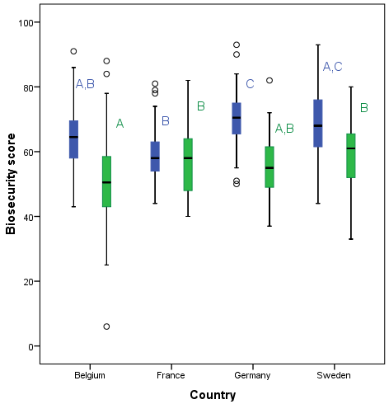
Biosecurity in four EU countries
External biosecurity = blue
Internal biosecurity = green
Letters:
Different =
sign different (ANOVA)
Postma et al. Animal, 2016
Large variation in status of biosecurity between and within countries

Slide 13

Associations biosecurity
More sows →
more employees
p< 0.01
#Employees
#Sows
#Employees
#Sows
#Sows
#Sows
BELGIUM, FRANCE, GERMANY, SWEDEN
>2 week →
less sows
p< 0.01
4 & >5 week
less
employees
p< 0.01
More sows → more WSY
p< 0.01 (country * # sows)
More employees → more females
p< 0.01
Higher internal → more vaccinated
p= 0.02
Farrowing rhythm
Farrowing rhythm
Farrowing rhythm
Farrowing rhythm
Internal biosecurity
Internal biosecurity
Mortality till weaning
Internal biosecurity
Mortality till weaning
Mortality till weaning
Mortality till weaning
Gender person farrowing
Gender person farrowing
Gender person farrowing
Gender person farrowing
Pathogens vaccinated
Pathogens vaccinated
Pathogens vaccinated
Pathogens vaccinated
Higher mortality
→ less WSY
p< 0.01
Higher internal → higher external
p< 0.01
3 week → higher weaning age
p< 0.01
More employees →
higher external
p< 0.01
Average daily weight gain
Average daily weight gain
Average daily weight gain
Higher external →
more weaned
p= 0.02
Average daily weight gain
Number of weaned piglets per sow per year
Number of weaned piglets per sow per year
External biosecurity
External biosecurity
External biosecurity
External biosecurity
Later weaning → lower daily weight gain
p= 0.03
Higher weaning age → less WSY
p< 0.01
Weaning age
Weaning age
Weaning age
Weaning age
Postma et al. Animal, 2016
Notes:
Herds with more sows → more employees → better structured working + maybe more aware of risk of entrance pathogens → higher external biosecurity
Higher external → more weaned piglets
External associated with internal biosecurity
Higher internal → vacc against more pathogens → High disease pressure? Knowledge of disease transmission, reduction of risk by taking more preventive measures?

Slide 14
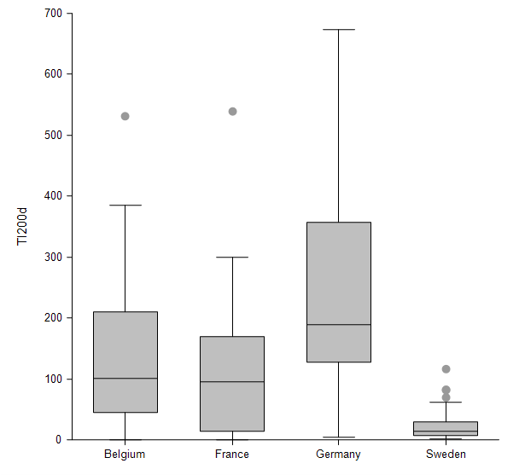
Results: AMU
  TI₂₀₀ = 150: meaning that over the full production length a pig is treated for 15% (=150/1000) of its lifetime
189.0
101.2
94.7
14.3
Sjölund et al. (submitted)

Slide 15
Associations AMU
Weaned piglets/sow/year
Weaned piglets/sow/year
BELGIUM, FRANCE, GERMANY, SWEDEN
Higher antimicrobial usage breeders →
Higher number of weaned piglets per sow per year
p= 0.06; ß= 0.006
Farrowing rhythm
Farrowing rhythm
Antimicrobial usage breeders
Antimicrobial usage breeders
External biosecurity
External biosecurity
Higher external biosecurity
→ Lower antimicrobial
usage growers
p< 0.01; ß= -0.032
Longer farrowing rhythm →
Lower antimicrobial usage grower; p< 0.01
Pathogens vaccinated
Pathogens vaccinated
Weaning age
Weaning age
Antimicrobial usage growers
Antimicrobial usage growers
Higher weaning age →
Lower antimicrobial
usage growers
p= 0.06; ß= -0.048
More vaccination
→ Higher antimicrobial usage growers
p<0.01; ß= 0.139
Higher antimicrobial
usage breeders →
Higher antimicrobial
usage growers
p< 0.01; ß= 0.006
Postma et al, PHM 2016
Notes:
AMU breeders → more weaned piglets → excretion in milk? (although not preferable due to resistance risk), farmer more active during farrowing process?, increased farrowing index due to less mastitis and endometritis?, high productive sows require more treatments?
AMU breeders → AMU growers → habit + disease pressure?
Vacc against more pathogens → higher AMU growers → attitude? → disease pressure not yet under control with vaccination?
Longer farrowing rhythm → lower AMU growers
Weaning later age → lower AMU growers
Higher external biosecurity → lower AMU growers

Slide 16
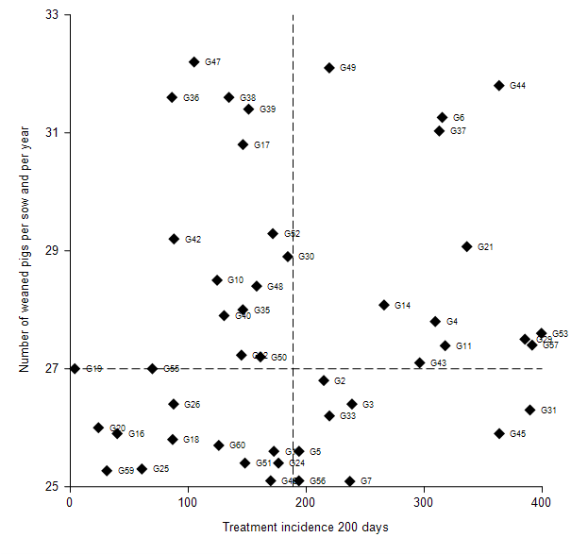
Results: Top farmers
Collineau et al., in prep.

Slide 17
Results: Top farmers
  On average higher internal biosecurity status
  Located in a more favorable environment (lower pig density and limited contact with wildlife)
  Treated less frequently against respiratory clinical symptoms in weaners and finishers
Collineau et al., in prep.

Slide 18


Project RED AB
Goal:
Significantly reduce antimicrobial usage by
Promoting prudent usage combined with
Farm optimization through
Guidance and with
Maintaining of production parameters

Slide 19
Project RED AB
61 pig herds (voluntarily)
Guidance + follow up (6-9 months)
  Farm management
  Production parameters
  Diagnostics
  Biosecurity (www.Biocheck.UGent.be)
  Antimicrobial usage (www.ABcheck.UGent.be)

Slide 20
Biosecurity – external
Results after interventions
Parameter | # herds | Visit 1 | Visit 3 | % difference
Biosecurity external | 61 | 63.7 | 66.1 | +3.7%
Purchasing policy | 61 | 85.0 | 88.1 | +3.6%
Removing animals, manure and carcasses | 61 | 66.8 | 71.0 | +6.2%
Supply of fodder, water and equipment | 61 | 34.0 | 35.1 | +3.9%
Access check | 61 | 62.3 | 64.1 | +2.8%
Vermin and bird control | 61 | 58.9 | 62.6 | +6.4%
Location and environment | 61 | 55.0 | 52.3 | -4.8%

Slide 21
Biosecurity – internal
Results after interventions
Parameter | # herds | Visit 1 | Visit 3 | % difference
Biosecurity internal | 61 | 49.1 | 56.1 | +14.2%
Disease management | 61 | 48.2 | 58.4 | +21.1%
Farrowing and suckling period | 61 | 37.3 | 44.3 | +18.8%
Nursery period | 61 | 54.4 | 57.7 | +6.1%
Fattening period | 61 | 60.8 | 65.9 | +8.3%
Compartimentalizing, working lines and equipement | 61 | 39.8 | 46.8 | +17.5%
Cleaning and disinfection | 61 | 47.1 | 55.5 | +18.0%

Slide 22
AM reduction RED AB project

Slide 23
Technical data RED AB project
Parameter | # herds | Visit 1 | Visit 3 | % difference
Weaned / sow / year | 48 | 26.5 | 27.5 | +3.8%
Mortality till weaning | 48 | 12.9 | 12.6 | -2,3%
Feed conversion ratio | 47 | 2.7 | 2.6 | -5.2%
Mortality finishers | 36 | 3.2 | 2.6 | -18.5%
Growth | 33 | 669.3 | 675.2 | +0.9%
Positive evolutions in production parameters

Slide 24
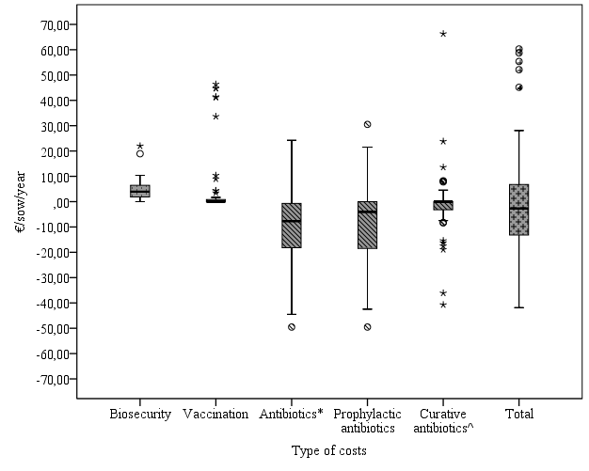
Economically profitable
Net benefit
€ 42,99 per sow/year
€ 2,67 per finisher/year
Rojo Gimeno & Postma et al, revision submitted

Slide 25
How much can we reduce AM usage in pig farming and at which cost?

Slide 26
Intervention study
Multi country:
  Belgium; France; Germany; Sweden
67 herds
Interventions
  Improved internal / external biosecurity
  Vaccination
  Changes water / feed schemes
  Herd management
Overall good compliance with the initial plan

Slide 27
AMU before and after intervention
Across the 4 countries
Median TI_{200d} before: 247.3
Median TI_{200d} after: 160.2
P < 0.001 ***
-35.2%
TI_{200d} before intervention
TI_{200d} after intervention
Lösken et al., in prep

Slide 28
Farm technical performances before and after intervention
Farm technical performances before and after interventions
 | Before intervention | After intervention | P value*
Number of litters per sow per year | 2.5 | 2.4 | 0.115
Number of weaned piglets per sow and per year | 27.5 | 28.0 | 0.006
Mortality in suckling pigs | 13.4 | 14.0 | 0.109
Mortality in weaners | 2.2 | 2.1 | 0.820
Mortality in fatteners | 3.5 | 3.3 | 0.583
*Significance of the paired t-test
Collineau et al., in prep.
No impact on mortality
Slight increase of the number of weaned piglets per sow and per year

Slide 29
Take home message
Room for improvement Biosecurity & AMU
Better biosecurity → more piglets weaned
Better biosecurity → lower AMU
Higher weaning age → lower AMU
Reduction AMU possible
Tools to improve animal health & productivity
and to minimise antimicrobial usage
Notes:
Take home messages
Although not presented we found that in the four countries there is still room for improvement in both the biosecurity level as well as the antimicrobial usage
If herds manage to get a higher (mainly external, but this is associated with the internal) biosecurity they can wean more piglets
A better biosecurity was also associated with a lower AMU
And herds who weaned the piglets at an older age also showed a lower AMU
We think that these findings are nice tools to improve animal health and productivity and on the other hand to reduce AMU

Slide 30

REB AB project
Supervising:
Prof. Dr. Jeroen Dewulf
Prof. Dr. Dominiek Maes
Executing:
Merel Postma, DVM
With help from:
Wannes Vanderhaeghen, MSc, PhD
Philippe Gelaude, DVM
Acknowledged:
Farmers
Herd veterinarians
Herd advisors
The MINAPIG consortium
Supervising:
Prof. Dr. Katharina Stärk
Prof. Dr. Elisabeth grosse Beilage
Dr. Catherine Belloc
Prof. Dr. Jeroen Dewulf
Prof. Dr. Ulf Emanuelson
Prof. Dr. Christian A. Körk
Executing:
Annette Backhans, DVM, PhD
Lucie Collineau, DVM, MSc
Svenja Lösken, DVM
Elisabeth O. Nielsen, DVM, PhD
Merel Postma, DVM
Marie Sjölund, DVM, PhD
Vivianne Visschers, MSc, PhD
Supporting:
Prof. Dr. Ann Lindberg
Hugo Seemer, DVM, PhD
Petra Maas, DVM, PhD
  MINAPIG consortium – www.minapig.eu

Slide 31

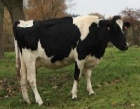
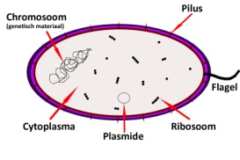
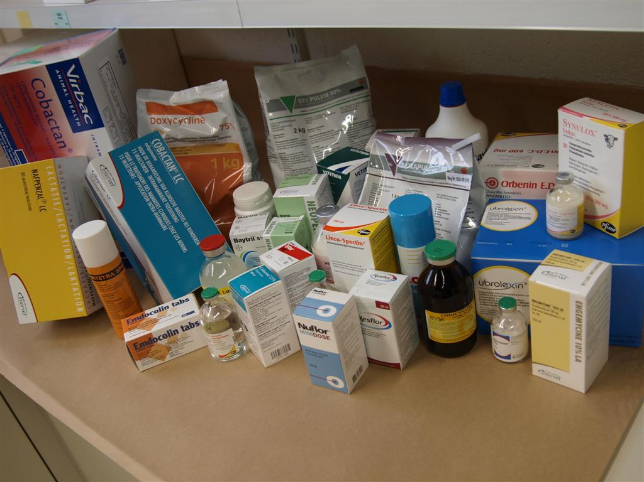
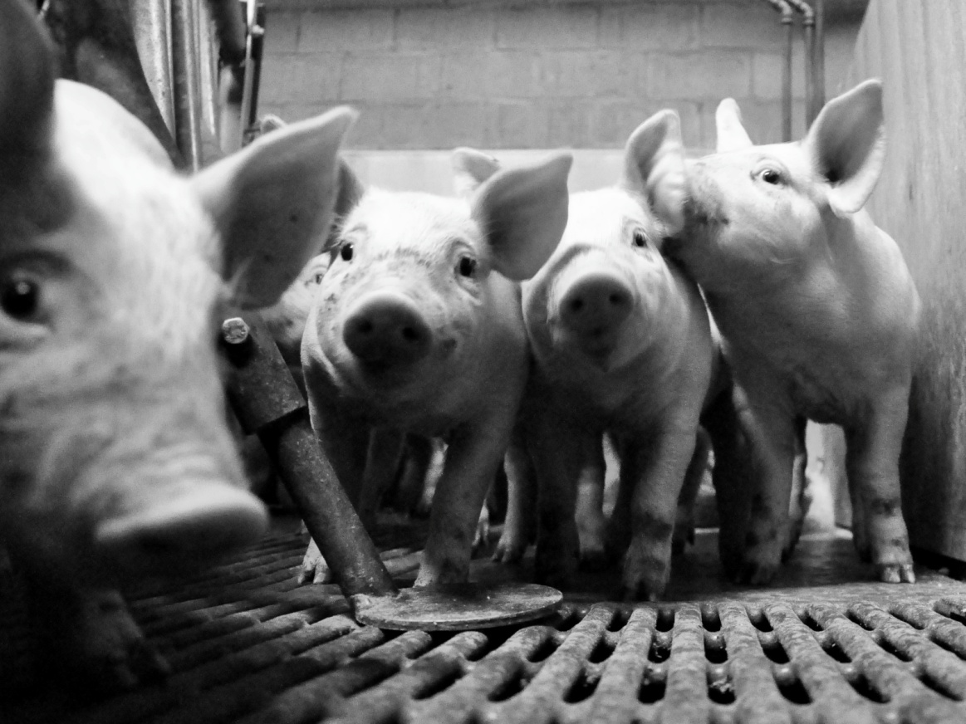
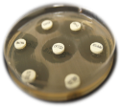
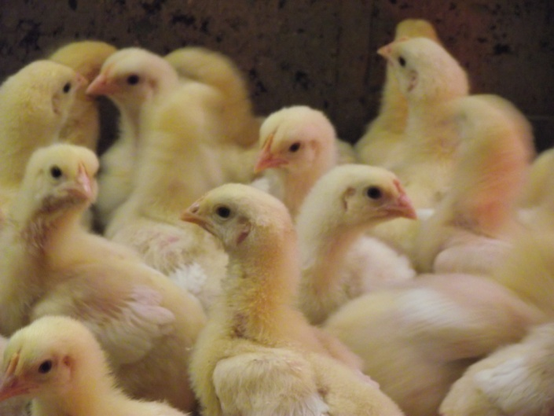
Merel.Postma@UGent.be
www.Biocheck.UGent.be www.ABcheck.UGent.be
ABcheck: Check, improve and reduce!
www.ABcheck.ugent.be

Slide 32
Results: AMU
 | Country
Antimicrobial class | Belgium | France | Germany | Sweden
Aminoglycosides | 0.0% | 7.9% | 1.2% | 0.2%
Aminopenicillins | 37.7%¹ | 15.7%³ | 35.7%¹ | 6.2%⁴
Amphenicols | 0.1% | 0.5% | ˂0.0% | 0*
Benzylpenicillin | 0.4% | 0* | 1.0% | 61.2%¹
Benzylpenicillin in combination | ˂0.0% | 2.1% | 4.6% | 0.9%
3rd & 4th generation Cefalosporins | 10.8%⁴ | 1.2% | 1.8% | 0*
Fluoroquinolones | 5.3% | 0.4% | 1.3% | 1.3%
Macrolides | 14.7%³ | 12.6%⁴ | 18.1%² | 9.0%³
Macrolides in combination | 1.6% | 2.9% | 0.5% | 0*
Polymixins | 17.5%² | 30.1%¹ | 13.6%⁴ | 4.3%
Sulfonamides and trimethoprim | 5.1% | 8.0% | 3.4% | 13.1%²
Tetracyclines | 6.8% | 18.2%² | 17.3%³ | 2.9%
Tiamulin | 0.1% | 0.5% | 1.3% | 1.0%
Valnemulin | 0* | 0* | 0.1% | 0*

Slide 33
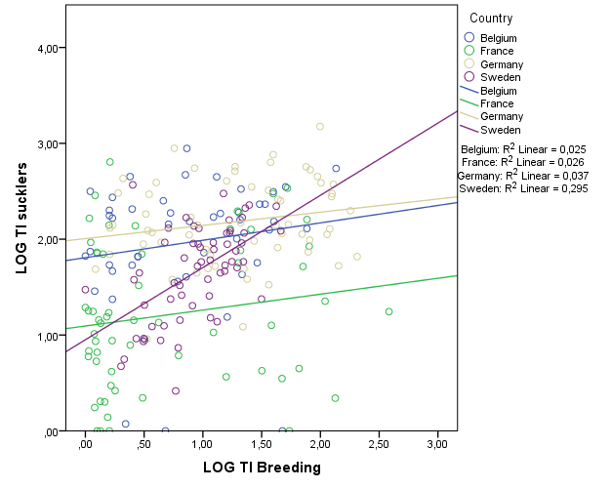
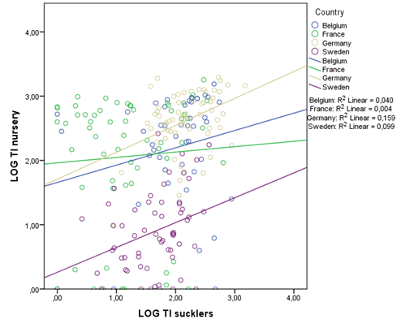
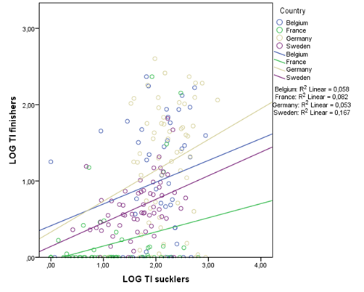
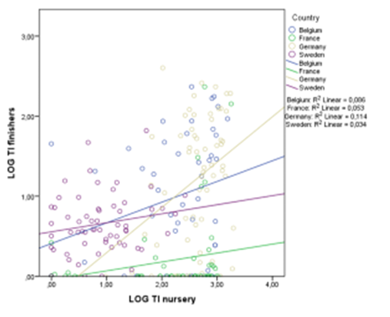
Results: AMU
Sjölund et al, submitted

Slide 34
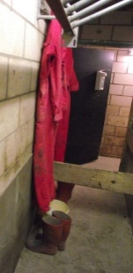
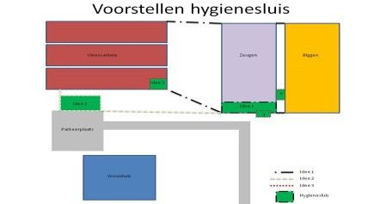
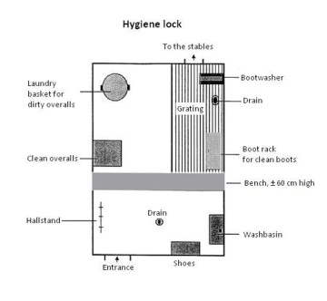
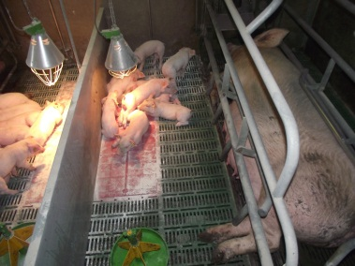
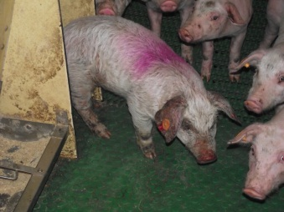
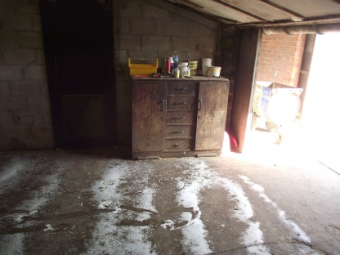
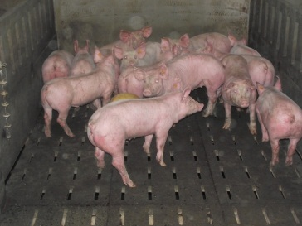
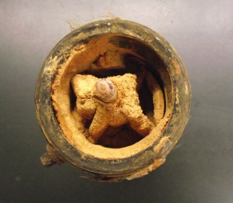
General recommendations
“General biosecurity”
    Clean & dirty road
    Hygiene lock
    Quarantine gilts
    Between animal categories
    Manipulation of piglets
    Cleaning and disinfection
    Euthanasia policy
    Stocking density
    Water quality
Supplemental vaccination
  E. Coli, PRRS, PCV, Glässers, …
Clean
Dirty
Animals moving out
Clean road
Dirty road
Quarantine stable
Hygiene lock
Entrace animals

Slide 35
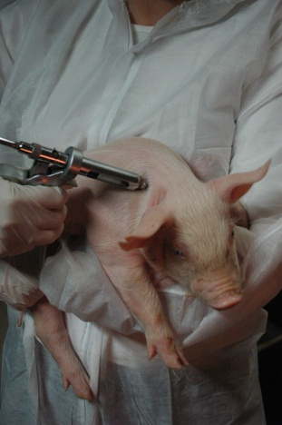
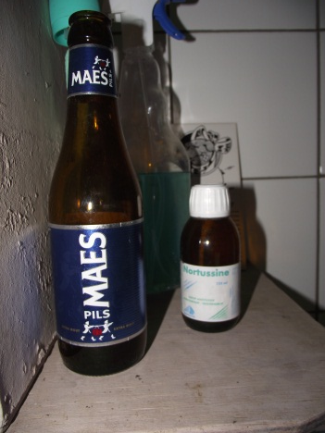
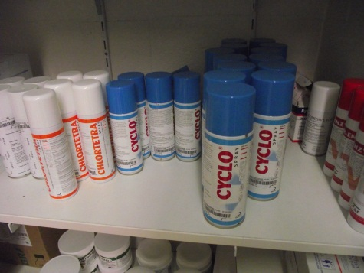
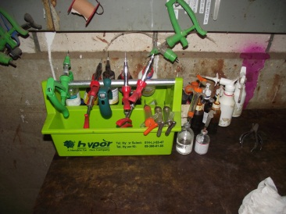
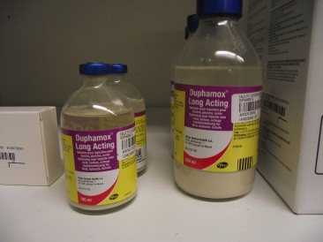
General recommendations
Prudent usage
  Correct dosage&duration
  Correct active substance
  Indication/diagnosis
  Storage
  Critically important
Prophylactic → curative
  Standard group →
  individual sick pig

Slide 36
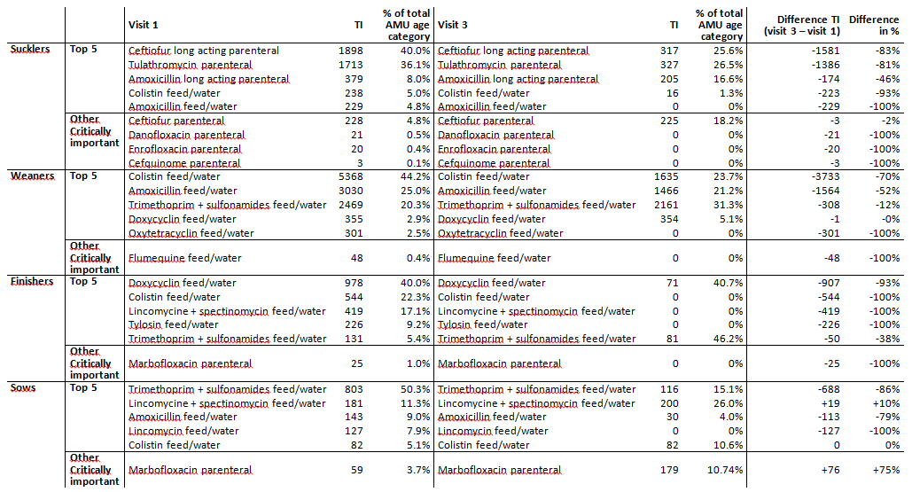
AM reduction RED AB project
-83% reduction standard use ceftiofur in piglets!

