Slide 1
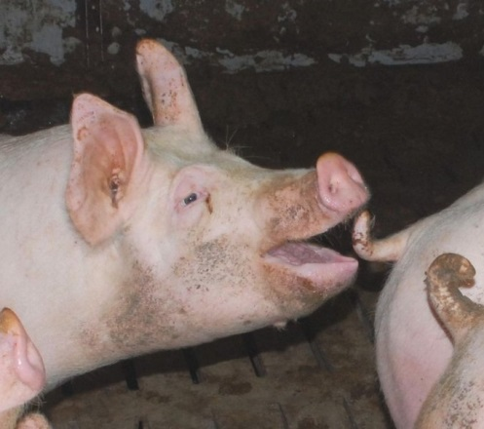
The long and short of it-
Irish farmer’s experiences of tail biting
Amy Haigh* and Keelin O’Driscoll
Amy.Haigh@Teagasc.ie

Slide 2
Origins
Tail biting surfaces and increases in all countries and in all housing systems
Move from small, extensive labour dependent enterprises into large, intensive capital dependent production systems
1930s
1950s
1960s
Slatted floors began to displace deep straw bedded systems
First recognised but not a major problem

Slide 3
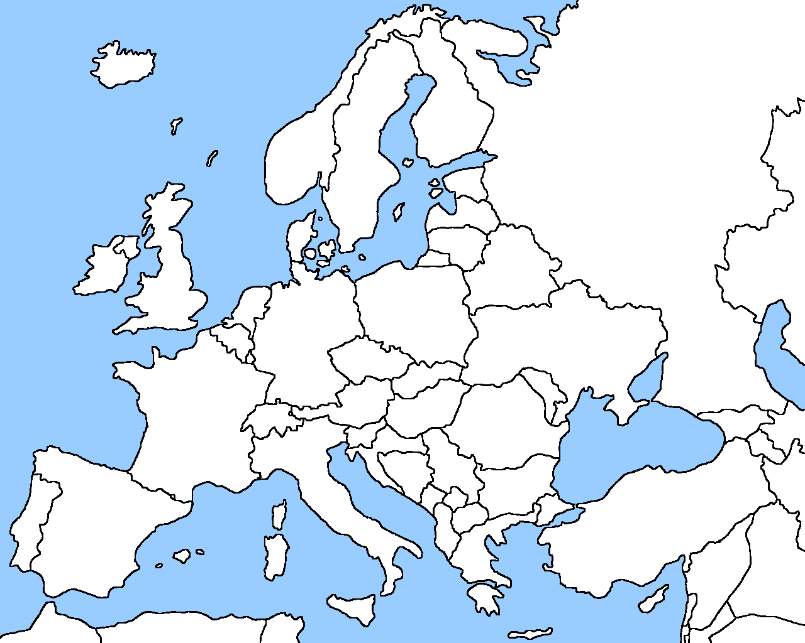
34.5% (Valros et al., 2004) of pigs displayed tail lesions
72.5% of study pigs (Harley et al., 2014) and moderate and severe tail lesions being present in 25.2% and 3.1% of pigs (Van Staaveren et al., 2015)
53% in a Dutch abattoir study (de Lauwere, 2009). Of 700 individual piglets = 95% was observed with tail damage at some stage (Zonderland, 2011).

Slide 4
Impacts
Camerlink et al. (2012)- tail biting irrespective of the severity of wounds grew less well which corresponded to a weight difference of approximately 4 kg at the end of the finishing period.
Correspondingly, Harley et al. (2014) found a significant negative effect of tail lesion severity on carcass weight, with a potential loss of 1.182kg (€0.59 per pig).

Slide 5
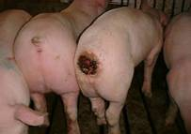
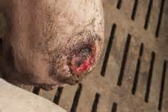
The wounded tail may become contaminated leading to abscesses of the hindquarters and the posterior segment of the spinal column
Secondary infection may occur in the lungs
Tail lesion severity was significantly associated with carcass condemnation which accounted for up to 70% of total carcass condemnations (Harley et al. 2014).
In Ireland Harley et al. (2014) calculated an economic loss value of € 1.69 per study pig.

Slide 6
Proposed causes
Taken from Farewelldock.eu (Bracke, 2010)

Slide 7
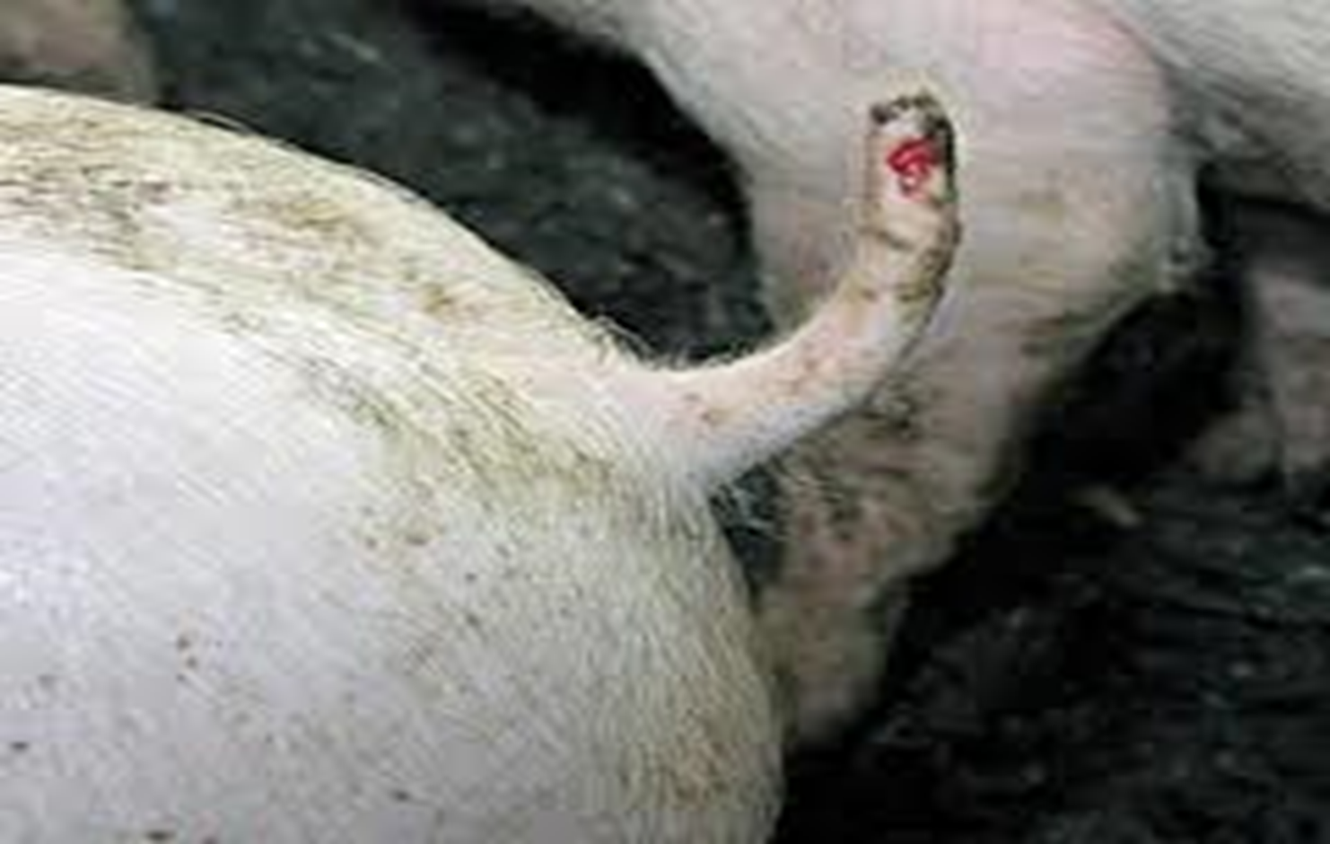
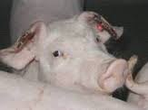
58 respondents from 21 counties
Size of farm, lines
Management
Biggest negatives of tail biting
Frequency of biting behaviour
Patterns observed
Biggest triggers
Remedial solutions
Enrichment

Slide 8
Reoccurring themes
“Tail biting is the biggest negative of pig production”
“Tail biting happens sporadically”
“Tail biting is horrible. The biggest negative for me is seeing a good pig destroyed”
“Weak pigs are the most destructive. It will be one or two pigs who will do it”
“The biggest problem with tail biting is trying to eliminate it”
“Biting doesn’t occur very often but it is very serious”

Slide 9
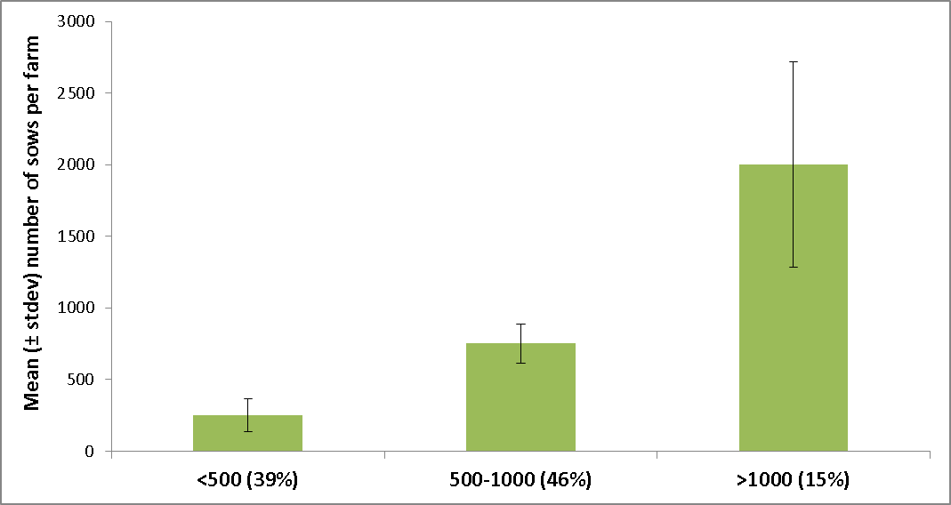
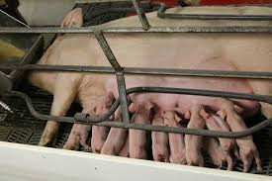
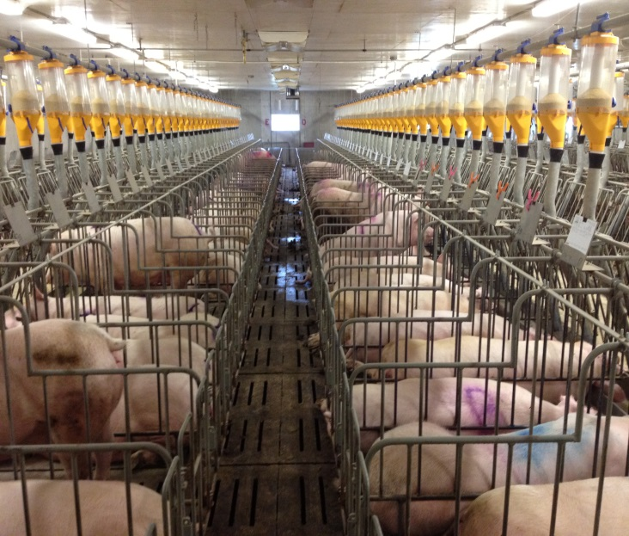
3000 Sows
693
90

Slide 10
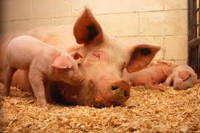
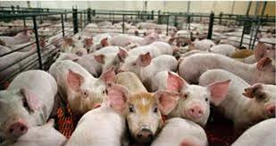
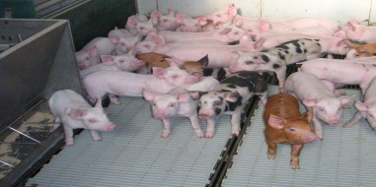
 |  |  | Range
 | Most common maternal line | Landrace/Large white
 | Most common terminal line | Danbred
 | Average 1st stage weaners per pen | 42 (±25) | 12-134
 | Average 2nd stage weaners per pen | 32 (±17) | 12-100
 | Average finishers per pen | 26 (±11) | 8-60
 | Percentage kept in mixed sex groups | 69%
 | Percentage kept in single sex groups | 31%
 | Percentage kept in same group from weaning | 17%
 | Percentage mixed at all stages | 66%

Slide 11
Biggest concerns
“One of the biggest negatives is having to isolate pigs”.
“If you don’t catch it in time and remove the bitten pig, there is no point sending it to the factory because it will be condemned”.
“It could cost 80-90 euro to feed a pig that is than ruined”.
“The welfare of the pig is the biggest negative of tail biting, it is clearly not comfortable”.
1.
Condemnation
2.
Loss of productivity
3.
Infection
4.
Hospital pen
5.
Other

Slide 12
96% had biting of some form on their farm that year

Slide 13
Patterns observed

Slide 14
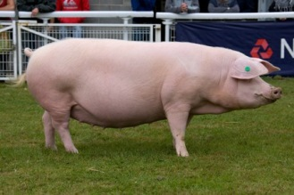
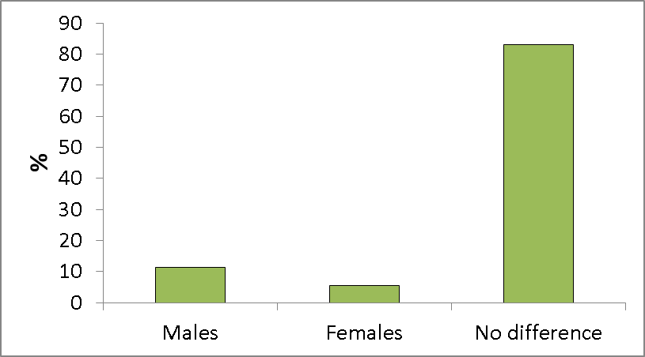
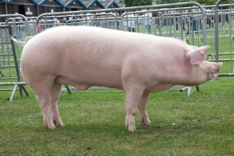

Slide 15
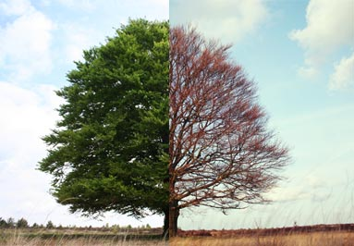
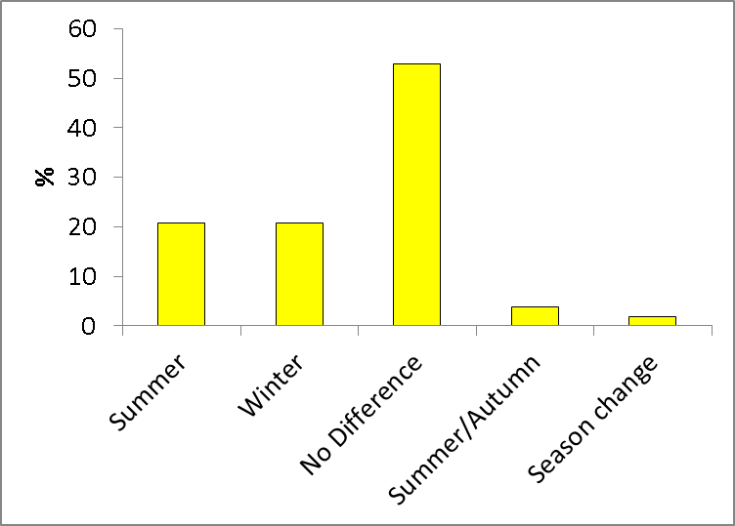

Slide 16
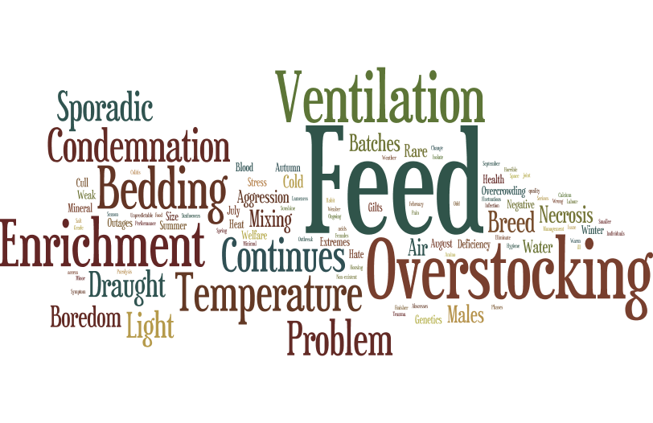
Supposed causes

Slide 17
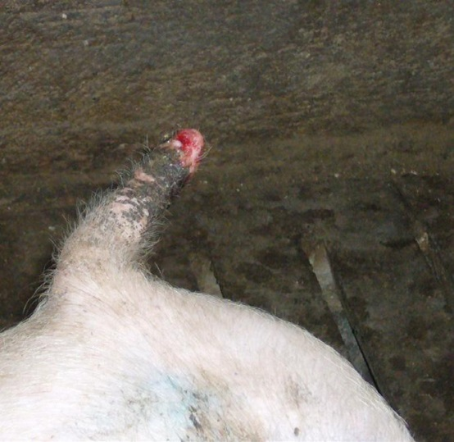
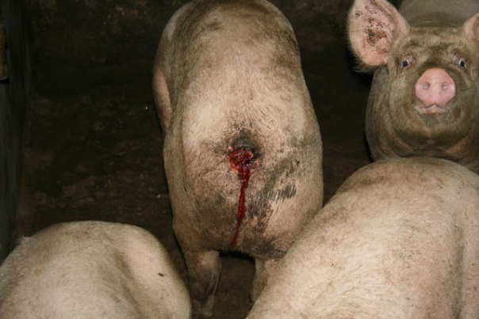
1. Pig health
2. Density
3. Feed
4. Draught/ventilation
5. Temperature
6. Adequate feed space
7. Water quality
8. Healthy/even growth
9. Enrichment
10. Hygiene
11. Mixing
12. Background
13. Adequate light
14. Natural light
15. Breed
16. Bedding
17. Feed time
18. Noise

Slide 18
In the event of an outbreak…

Slide 19
Enrichment
Suggestions that tail biting behaviour is redirected exploration behaviour.
As one respondent commented “Use of bedding material would no doubt prevent it. In the old days it would never have been a problem, the pigs are bored.”
Many respondents believed that “boredom has a big effect on tail biting” and have found various methods successful in reducing it.
65% of respondents adding additional enrichment following an outbreak. One respondent stated that if there is the slightest sign of agitation he puts in wood.

Slide 20
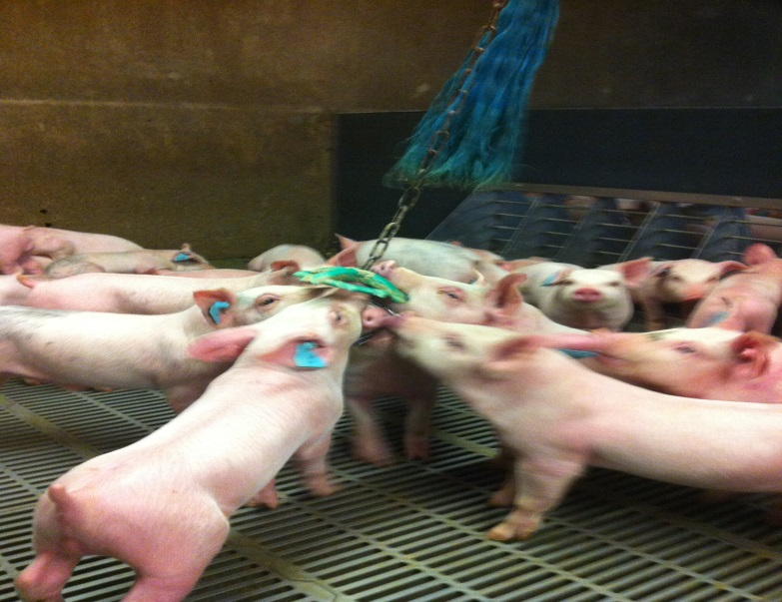
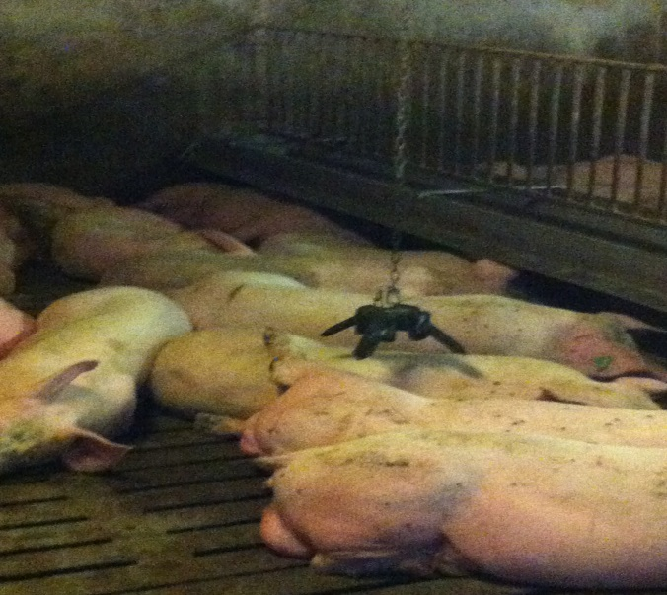
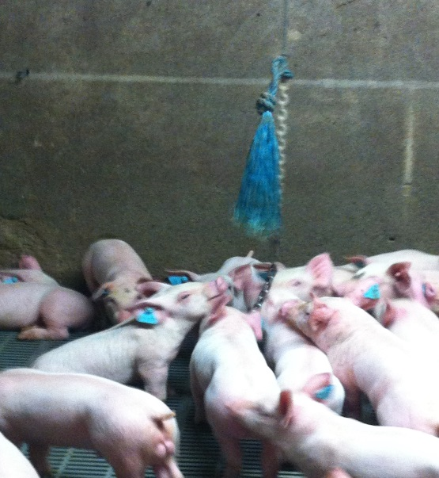
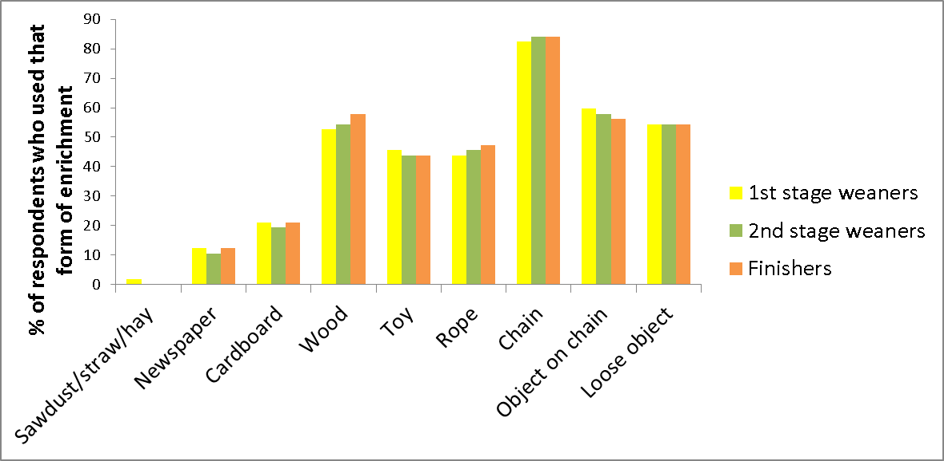
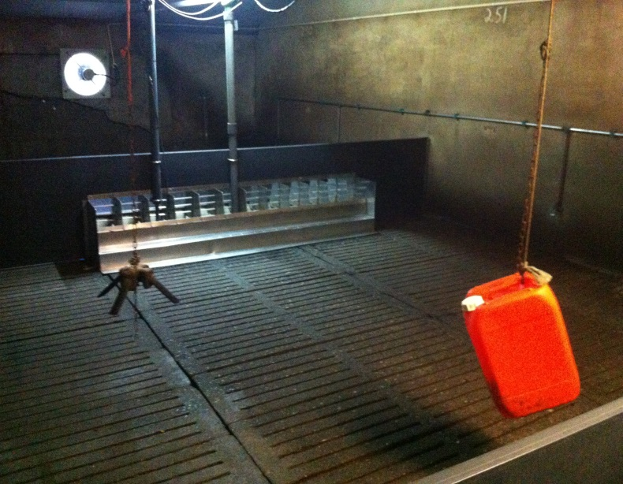
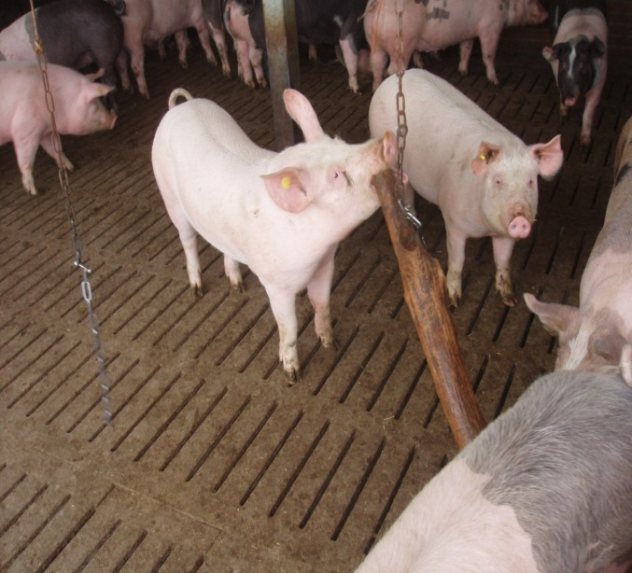
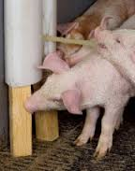
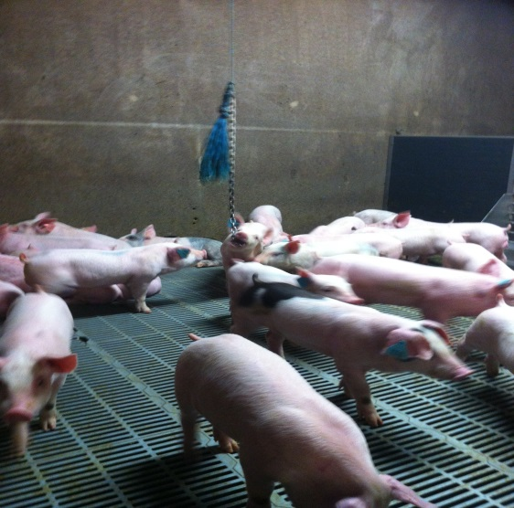
Enrichment used

Slide 21
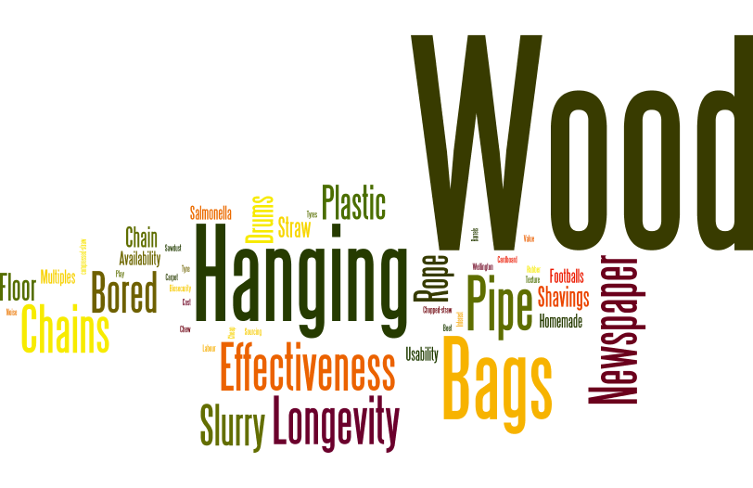
Enrichment considerations

Slide 22
81% would consider additional enrichment

Slide 23
Summary of main points
Abnormal behaviours such as tail biting are significant problems on Irish farms with 96% of respondents experiencing some form of biting in the last year.
Condemnation and loss of productivity rank as the greatest concerns.
Ear biting was found to peak in the 2nd stage, while tail biting reached its apex in the finishing stage.
Some of the biggest triggers were believed to be pig health, density/feed space and extremes in temperature, ventilation and dietary changes.
Enrichment was found to be useful in reducing the incidences of tail biting and stabilising it when it does occur, with 65% of respondents adding additional enrichment following an outbreak.
The biggest considerations when selecting enrichment included effectiveness and longevity, with chains, hanging devices and wood being used most commonly.

Slide 24
Thank you for listening

