Slide 1
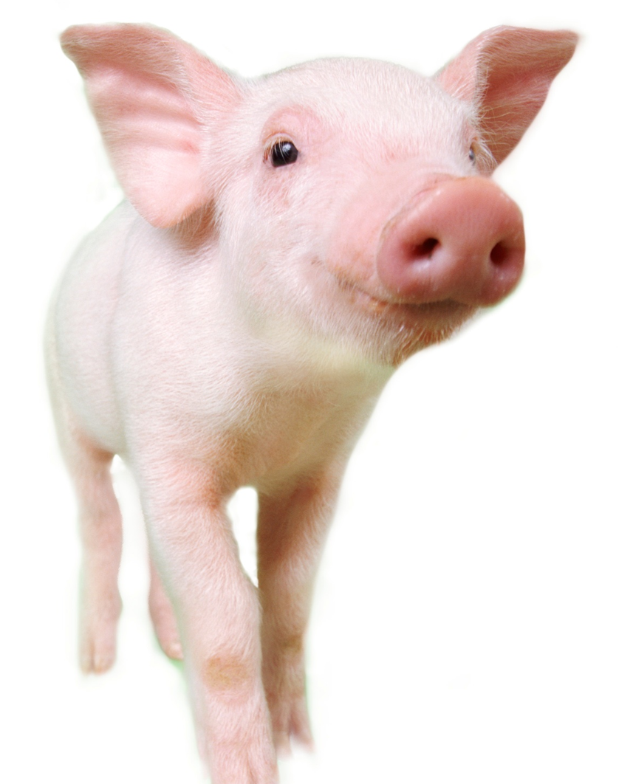
Mycotoxin assessment and mitigation; a holistic approach
Nick Adams
Global Director
Mycotoxin Management Team

Slide 2
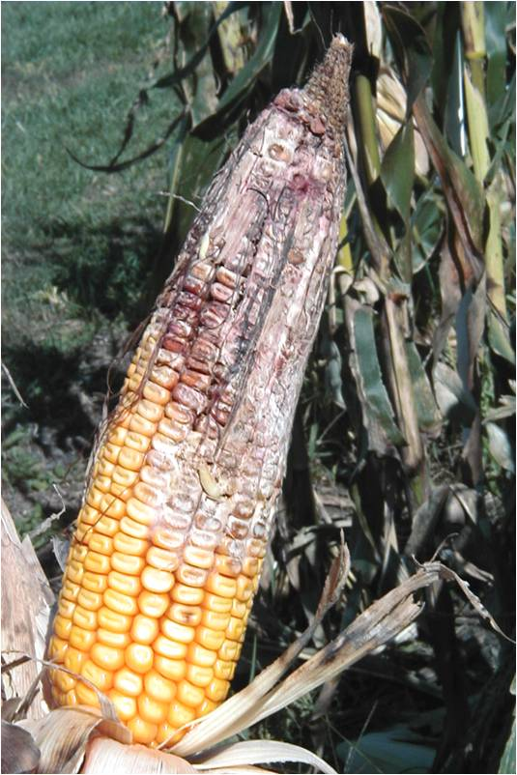
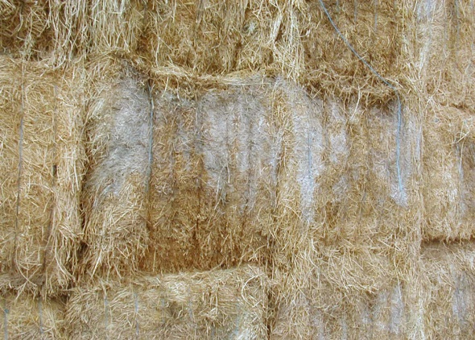
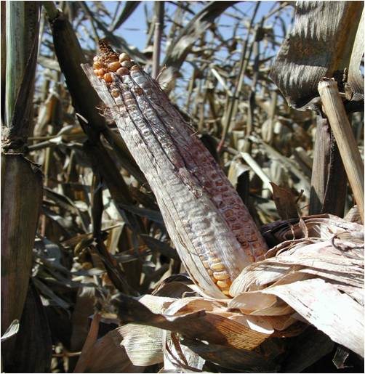
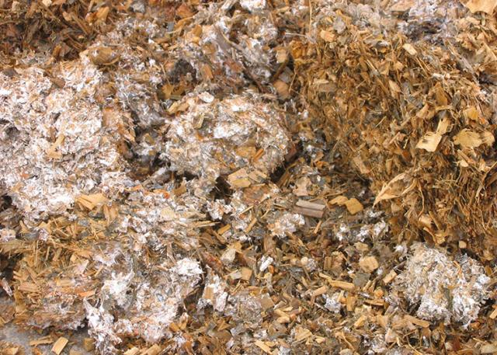
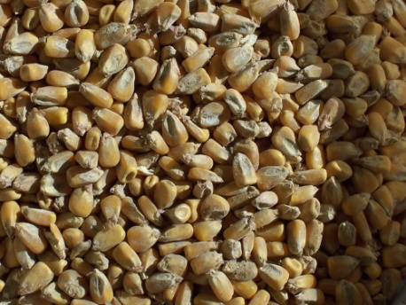

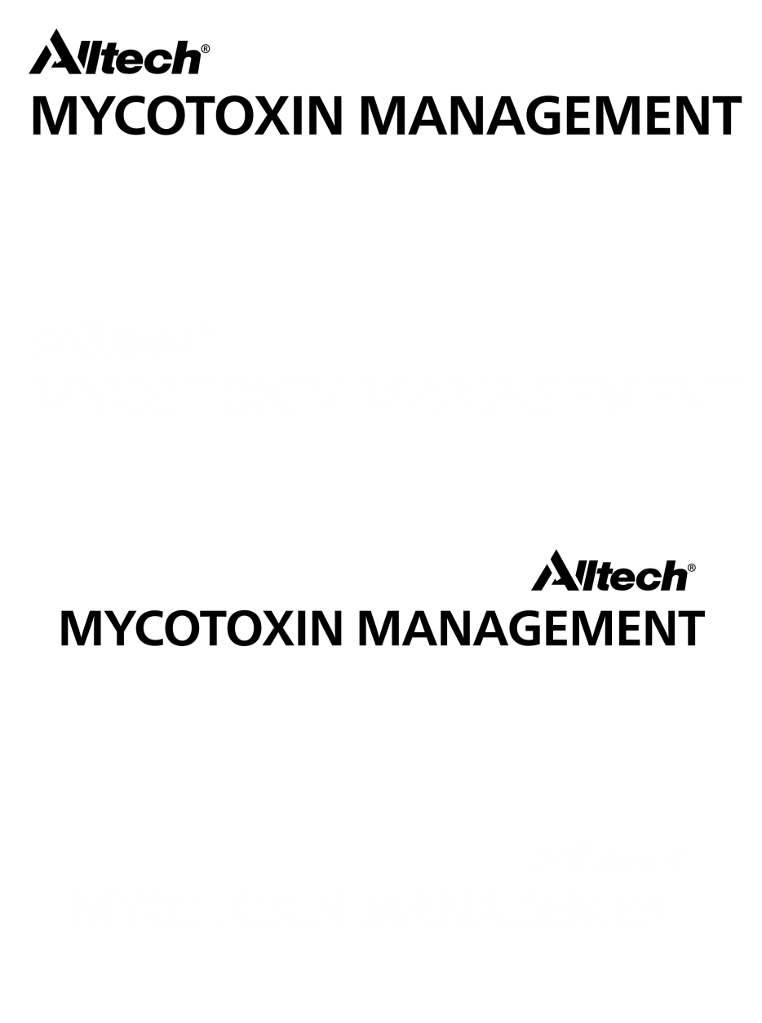
Field
Storage
Aspergillus &
Fusarium
Penicillium & Aspergillus
Initial risk
Evolving risk

Slide 3
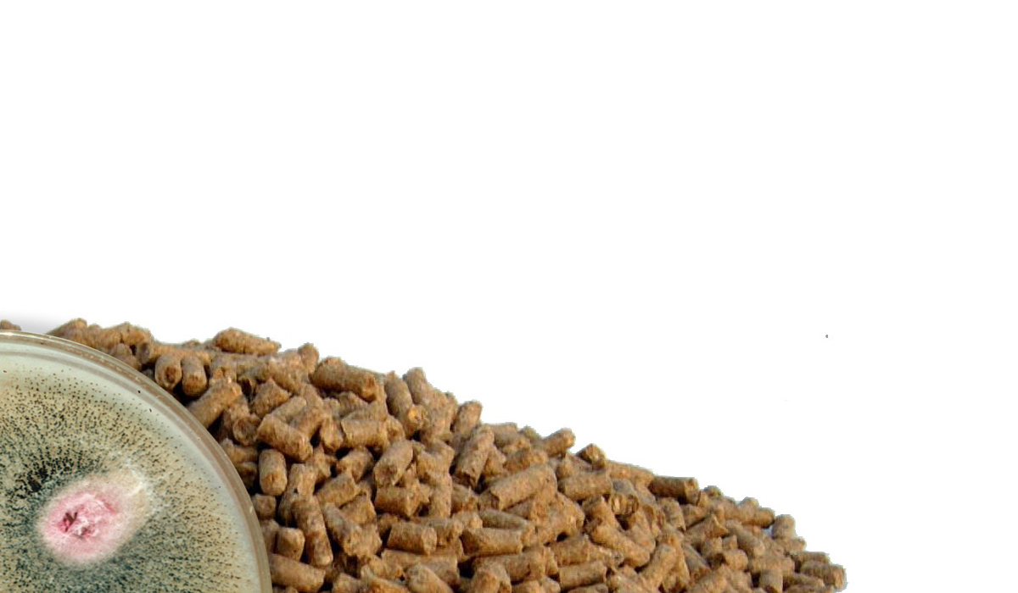
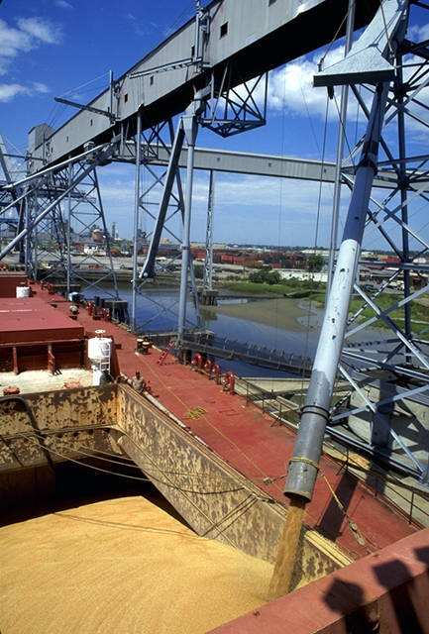
Why Increased Focus on Mycotoxins?
Global Issue/Trading
Increased Monitoring/Technology
Changing Agriculture Practices
Unexpected Weather
Food Safety/Regulations
Mycotoxin Interactions

Slide 4
AHDB risk assessment for fusarium mycotoxins in wheat
Key factors;
Location
Previous crop
Cultivation
Fungicide
Rainfall
Score in excess of 15 is deemed High Risk

Slide 5
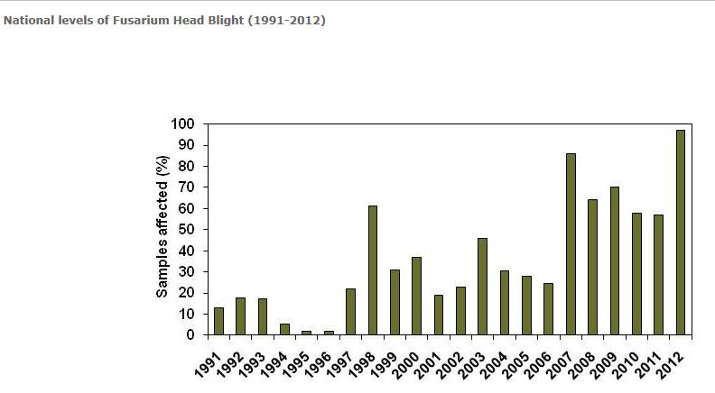

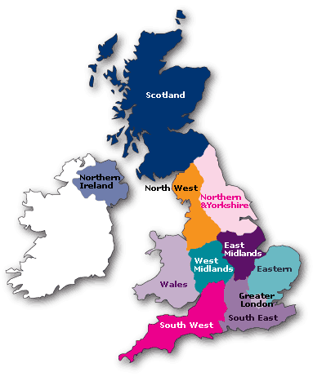
2012 wheat crop at high mycotoxin risk due to Fusarium head blight unprecedented contamination
Source: update from the UK DEFRA report – 17-8-12-

Slide 8


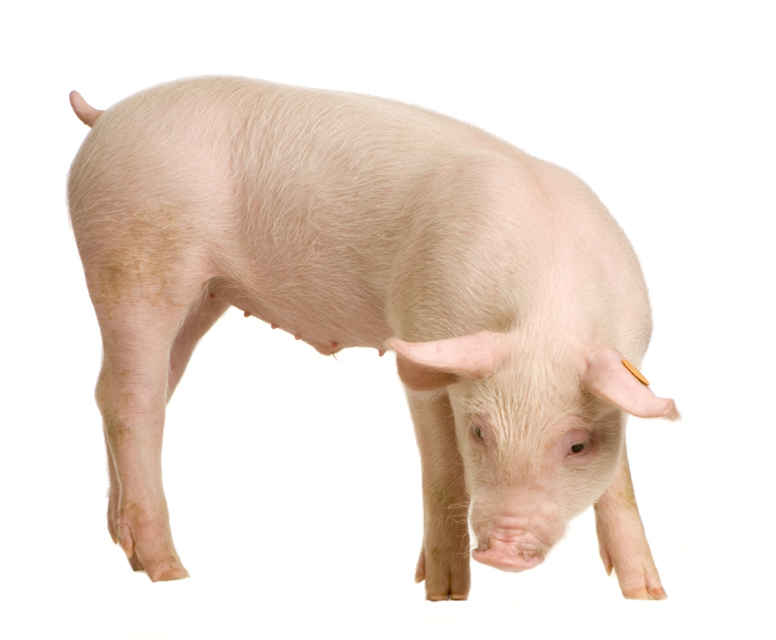
Mycotoxin impacts on pigs
DIGESTIVE DISORDERS
Lower feed intake
Intestinal damage/hemorrhaging
Inconsistent manure
IMMUNITY/HEALTH
Suppression of immunity
Low pathogen resistance
Increased health treatments
REPRODUCTION
Delayed maturity
Altered heat cycles
Vaginal swelling/prolapse
Infertility/poor conception
Notes:
Overall, these impacts come together to alter performance = lower gain, altered efficiency, increased days to market, decreased littler sizes, etc

Slide 9
Mycotoxins have a significant impact on the health and productivity of pigs
Mycotoxins
Animal Health
Damage to internal organs
Immunosupression
Productivity
Reproduction
Decrease in feed consumption
T-2, HT-2, DON,
OTA, FUM
DON, Pennicilium mycotoxins, AFL, FUM
ZEA, OTA, DON
DON, NIV, T-2, HT-2

Slide 10
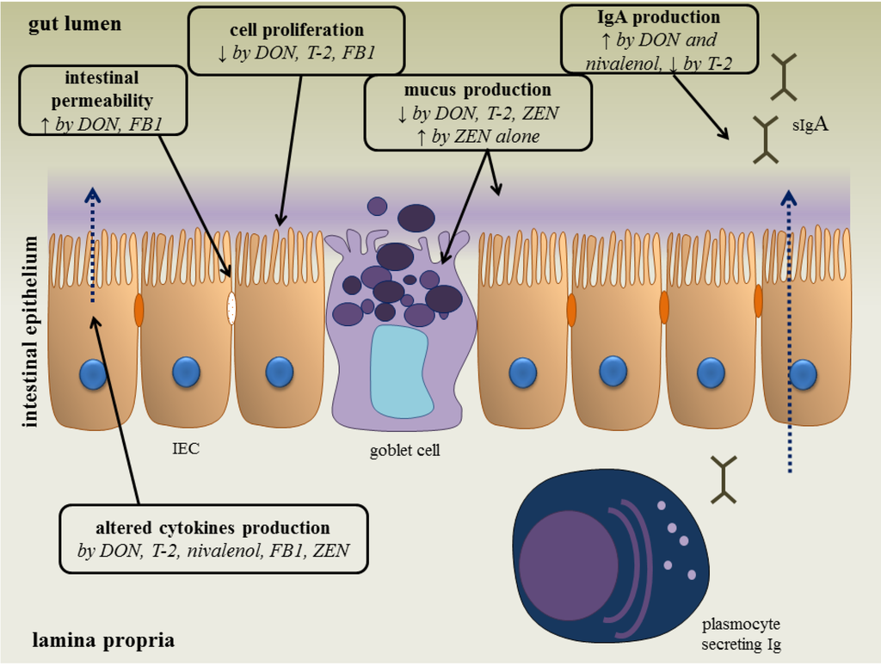
Antonissen et al., 2014
Notes:
Begins with the gut. Here, mycotoxins can have direct impact on cell structure and function. Additionally, impact on the intestinal lining can alter nutrient absorption/utilization, effect microbial pathogen populations, and impact the immune system.

Slide 11
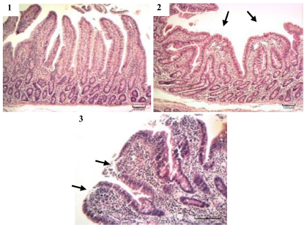
Impacts on nursery pigs
Impact of Type B Trichothecenes on jejunum villi structure
Control
DON = 1500ppb
DON = 3000ppb + NIV = 1300ppb + ZEA =1500ppb
(Gerez et al., 2014)

Slide 12

Linking REQ to Performance: Nursery
Overall average:
↓81 g/day
↑0.13 FCR
↓$7.42/pig
*Data compiled from 10 research trials
A. Weaver
Notes:
10 trials analyzed (935 pigs)

Slide 13


Mycotoxin Analysis
On Farm Assessment
Risk assessment
Report &
recommendation
Assessment
Report & recommendation
Treatment Options

Slide 14
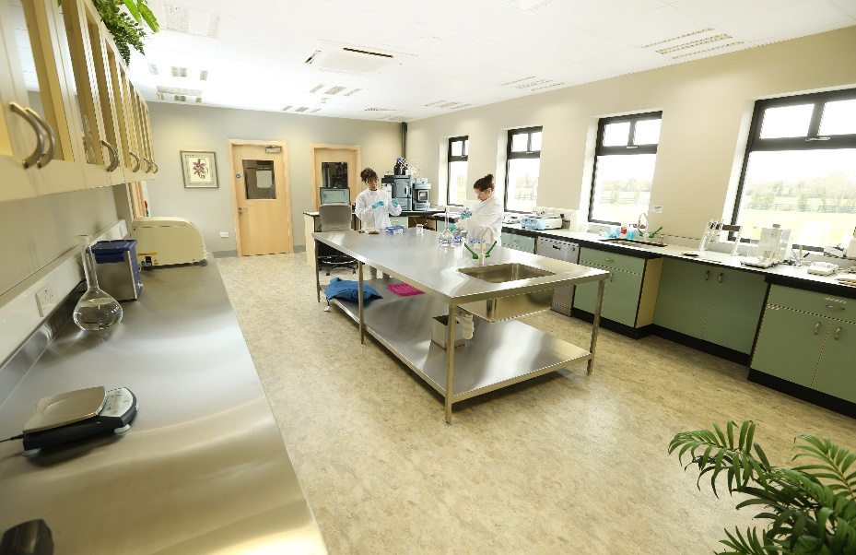

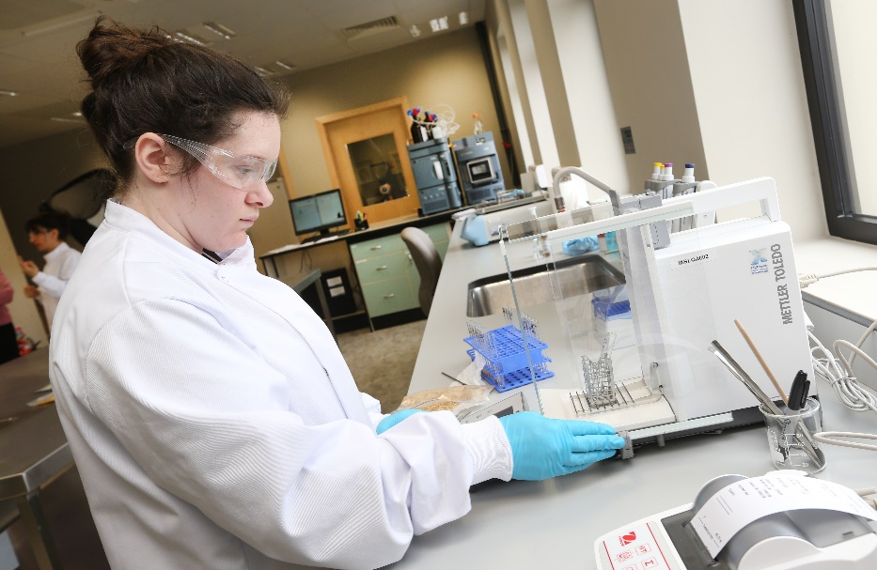
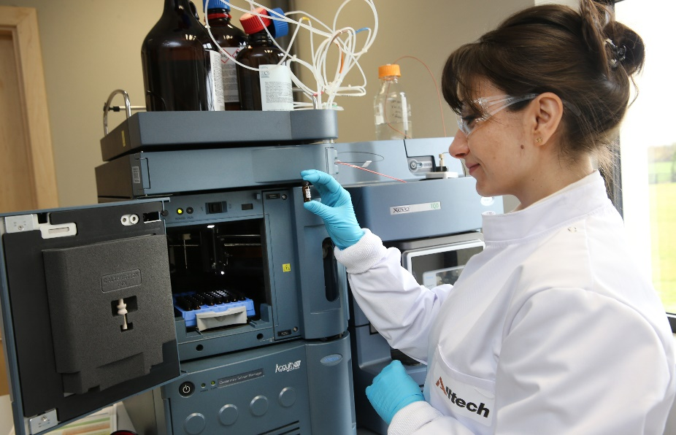

Slide 15
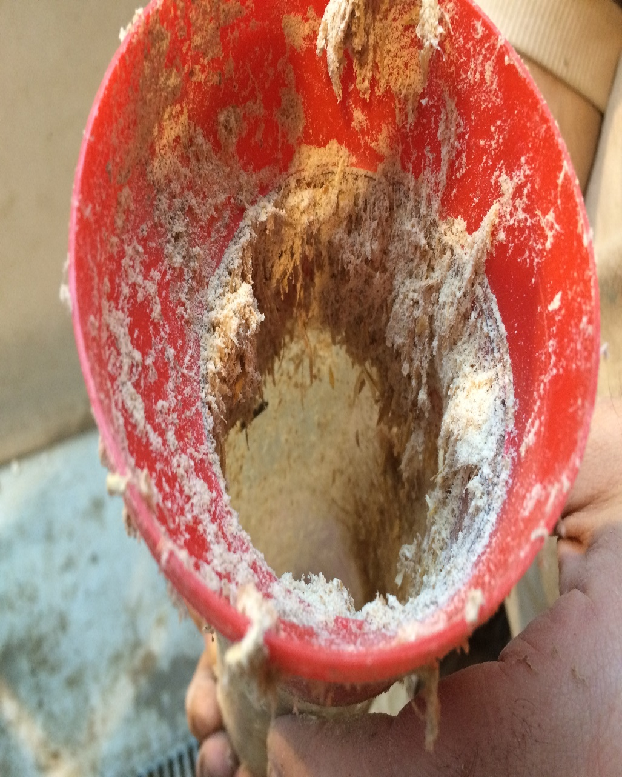
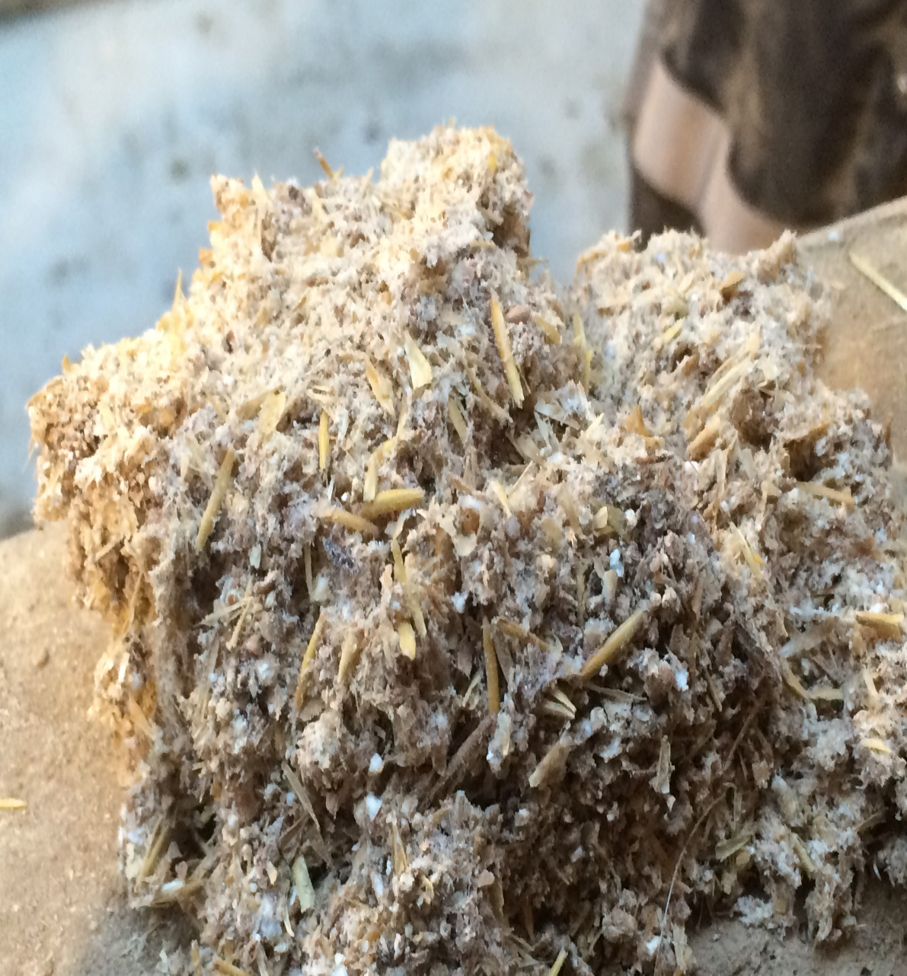
Meal Moth nest contamination allowing mould build up in sow auger feeding system

Slide 16
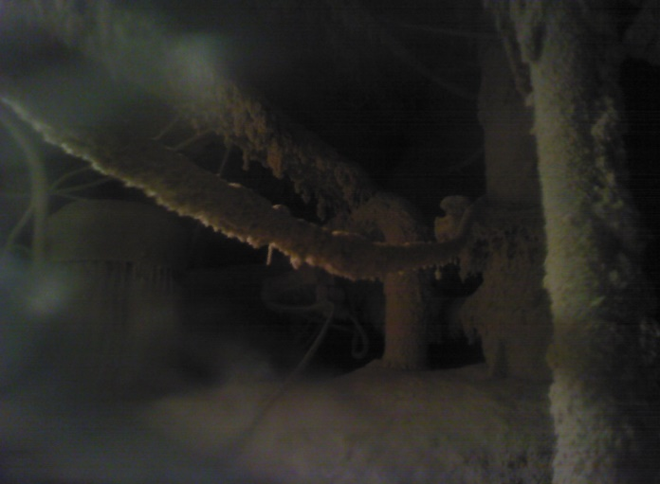
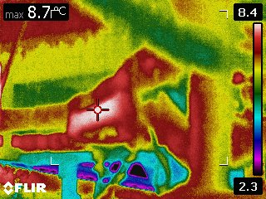
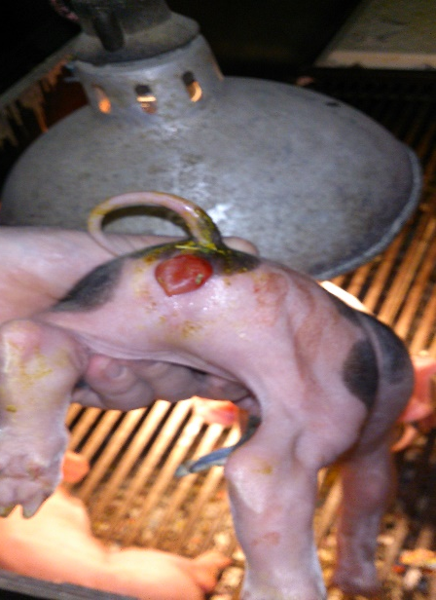
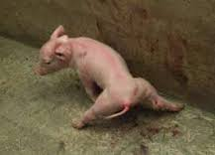
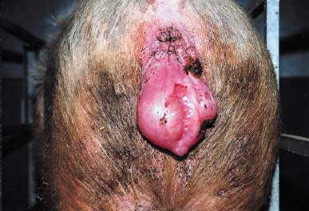

The Visual Signs
Storage: Pipework and Feeding lines
Pig health/fertility: Splay legs, enlarged vulva, prolapses

Slide 17
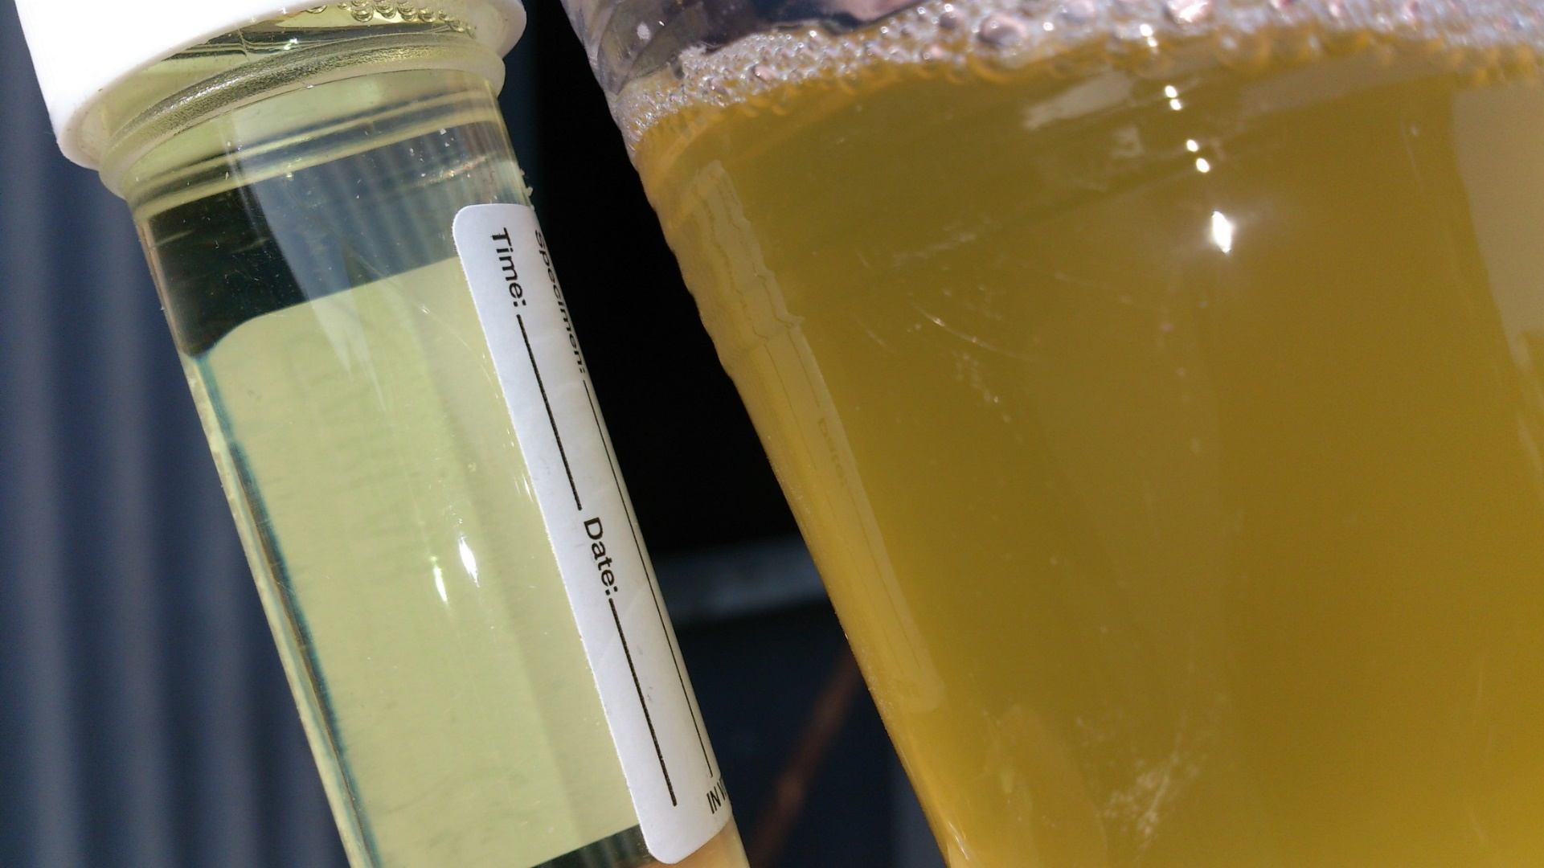
Sows Urine colour and clarity can be indicative of toxin build up in the kidneys

Slide 18
Mycotoxin assessment and mitigation; a holistic approach
Nick Adams
Global Director
Mycotoxin Management Team

