Slide 1
Keeping old sows in the herd
Oceane Schmitt

Slide 2
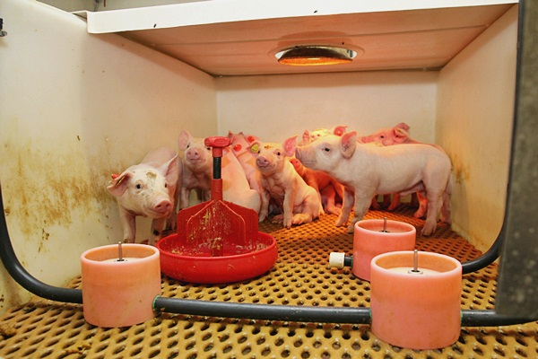
Farms visits
March
Denmark and The Netherlands
1 farm with Rescue Decks (The Netherlands)

Slide 3
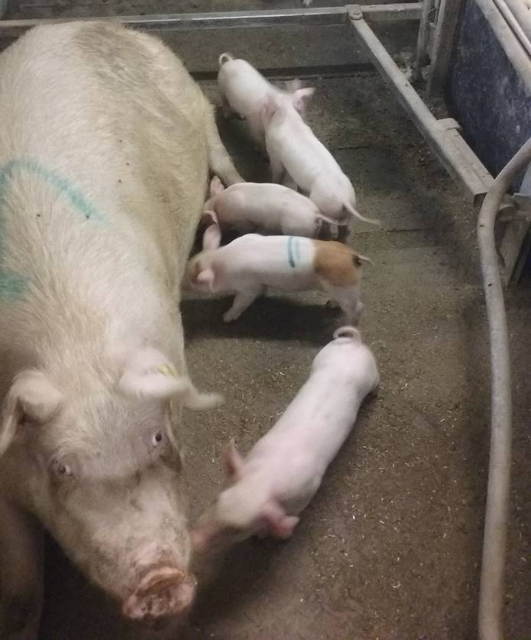
Farms visits
March
Denmark and The Netherlands
3 farms with free farrowing systems (Denmark)

Slide 4
Introduction
Maximum productivity = parity 3 to 5
Maximum income = parity 5
Economic interest to keep old sows in the herd
BUT
Concerns about rearing capacities of old sows (milk yield and quality)

Slide 5
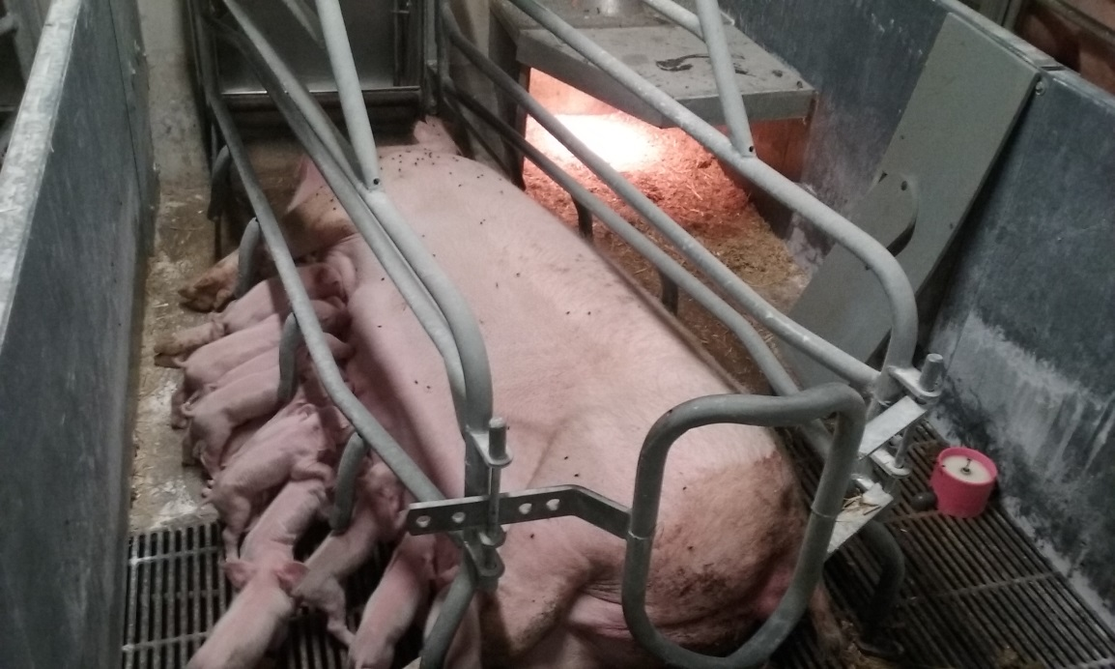
Rearing potential of old sows
Old sows are very common on Danish and Dutch farms
Rule of thumbs:
kept as long as they give birth to a large (>13 piglets born alive) and healthy litter.

Slide 6
Rearing potential of old sows
Increased litter size with parity rank but consequently smaller piglets
gilts also often give birth to small and very small piglets
Small piglets management
Sows up to parity 7 can easily wean 13 piglets
After parity 8: farrowing problems, and/or reduced milk yield and quality

Slide 7
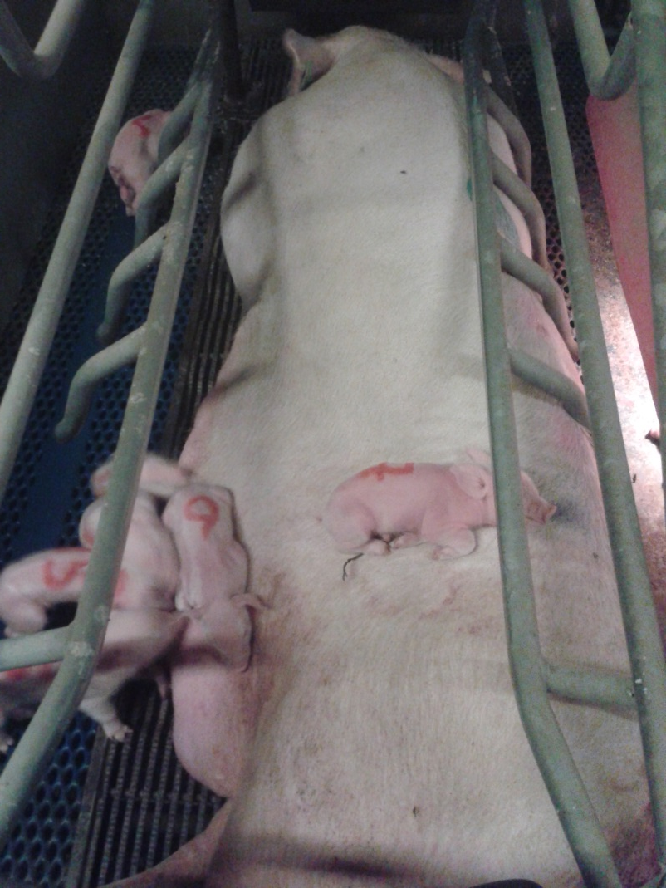
Old sows to rear small piglets
Better immunity = Higher IgG in milk and colostrum
Same quality of milk (protein, lipids, lactose)
(Hurley, 2015)
Less nervous = reduced risk of crushing

Slide 8
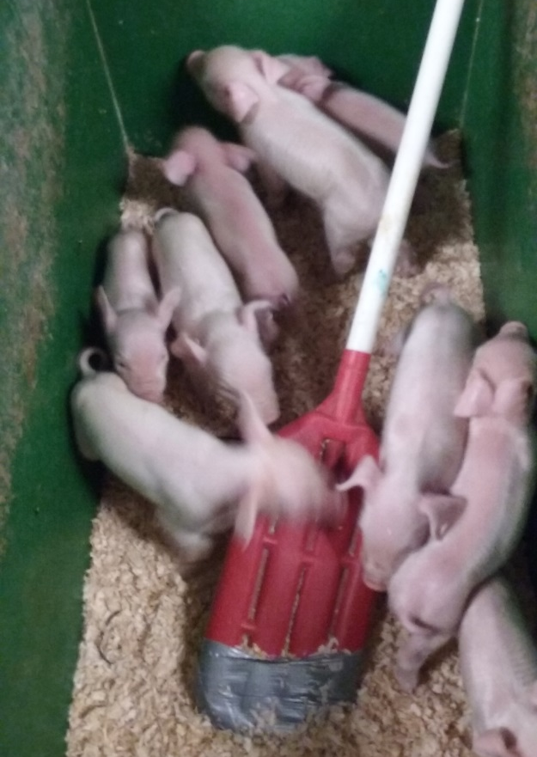
Old sows in fostering strategies
Better abilities to recognise biological piglets = reduced acceptance of alien piglets after D2
Recommendations:
Use only if newly farrowed
Mix alien and residents piglets

Slide 9
Old sows for small weaners
Old sows due to be culled
No need to inseminate
Good quality of milk
Economic strategy to ensure weaning weight

Slide 10
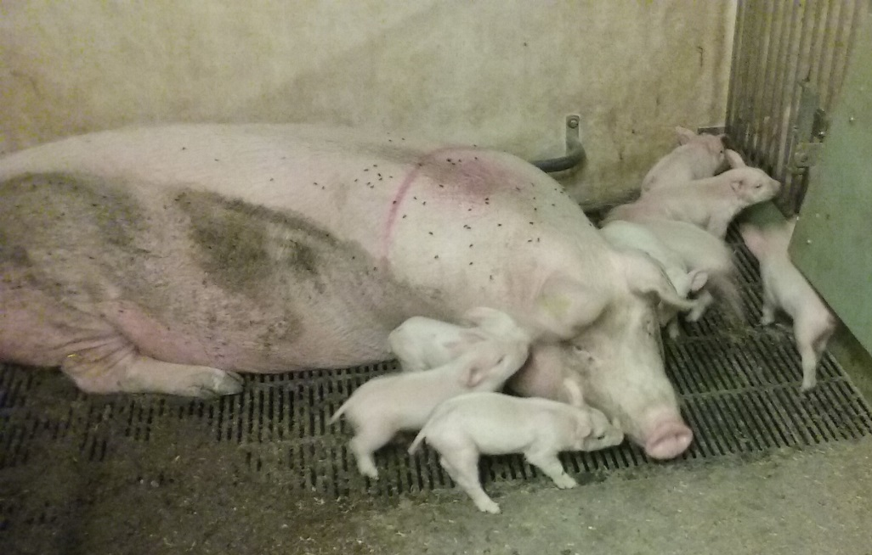
Conclusions
Old sows have an economic value
Better at rearing small piglets
economic gain for the farm
increasing importance since large litters are more and more common on farms

Slide 11
Thank you for your attention

