Slide 1
Dietary requirements for tryptophan and sulphur amino acids after weaning: is there a case for increasing their level of inclusion in diets?
Dr. John Pluske
School of Veterinary and Life Sciences,
Western Australia

Slide 2
Today’s presentation
Weaning process
“Essentiality” of some essential amino acids
Tryptophan
Sulphur amino acids
Concluding comments

Slide 3
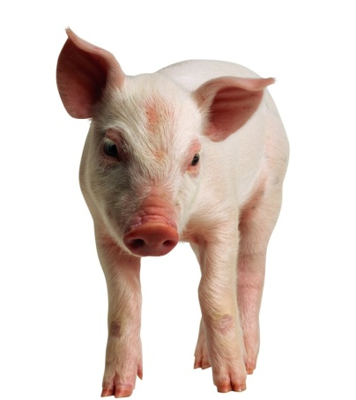
Weaning is a stressful event
Removal from sow and littermates
Fighting and establishment
of social hierarchy
Change in
environment
Increased exposure
to pathogens
Abrupt transition in diet
Transportation
stress
(Slide: Courtesy of Dr J.Campbell, APC)
Notes:
Let’s remember how we stress these pigs out: we take them away from their sow and littermates, we throw them in a new group of pigs and then we move them onto a truck or to a new house. Then we give them a completely new diet, not to mention, they’re exposed to an entire new set of pathogens.

Slide 4
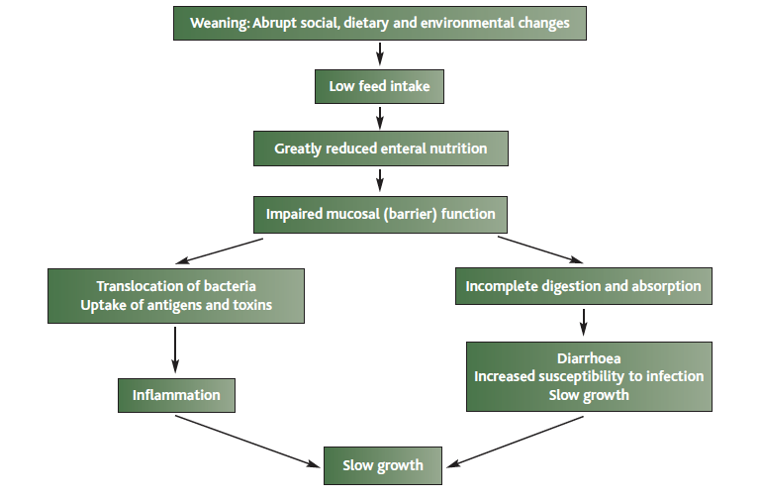
The post-weaning malaise
(Wellock et al., 2013; The Pig J. 69:56-74)

Slide 5
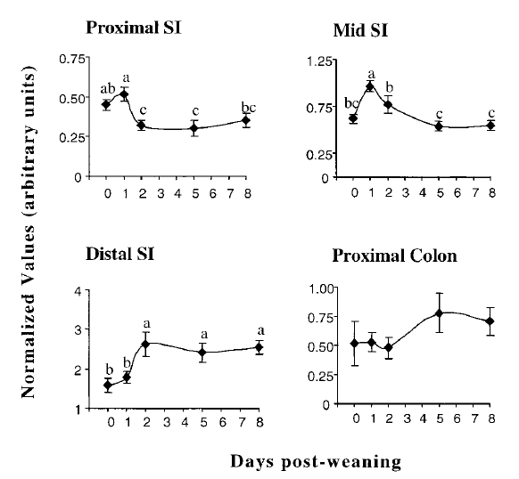
Weaning increases production of pro-inflammatory cytokines
Weaning is associated with an early and transient response in gene expression of pro-inflammatory cytokines in the gut
The (transient) rise corresponds with both low feed intake and the stress (disease?) associated with weaning
Pattern of TNF-α mRNA expression in the proximal, mid-, and distal SI in the proximal colon of the intestine of piglets on the day of weaning (d 0) and on d 1, 2, 5, and 8 after weaning
(Pie et al., 2004; J. Nutr. 134: 641-651)

Slide 6
What is the impact of weaning (and all that goes with it – disease, stress…) on the young pigs’ nutrient requirements?

Slide 7
Immune system activation affects performance of pigs (6-27 kg LW)
Item | Immune system activation | Dietary lysine, % of the diet
 |  | 0.60 | 0.90 | 1.20 | 1.50
Daily gain, grams | Low | 400 | 556 | 644 | 663
 | High | 357 | 495 | 510 | 504
Daily feed intake, grams | Low | 896 | 1025 | 1052 | 1002
 | High | 889 | 954 | 889 | 911
Gain:feed, g per g | Low | 445 | 544 | 613 | 662
 | High | 395 | 522 | 581 | 565
(Williams et al., 1997; J. Anim. Sci. 75: 2463-2471)

Slide 8
Pigs without clinical disease signs can still perform poorer
Oral infection with Lawsonia intracellularis (LI)
Clinical infection 10⁸-10⁶ LI per pig
Subclinical infection 10⁵-10⁴ LI per pig
(Paradis et al., 2012; J. Swine. Health Prod. 20: 137–141)

Slide 9
Immunonutrition: Using selected essential amino acids to restore the structure and function of the gut more rapidly and efficiently

Slide 10
1. Tryptophan

Slide 11
Background
Weaners reared in unsanitary (‘dirty’) conditions without antimicrobials show poorer growth rate and lower plasma Trp levels (compared to medicated feed and pigs housed in ‘clean’ rooms)
Plasma Trp concentration decreases during chronic lung inflammation of pigs associated with increased Trp catabolism [indicated by greater induction of indoleamine 2,3 dioxygenase (IDO) activity]
IDO activation creates conditions that favor immune suppression and tolerance
Studies have also shown that additional Trp supplementation,
Allows susceptible [to F4 enterotoxigenic (ETEC) E. coli infection] pigs to partially compensate for the effects of ETEC challenge by increasing feed intake and maintaining adequate growth
Favourably interacts to reduce the bacterial induction of some genes involved in the intestinal barrier in ETEC-susceptible pigs

Slide 12
Linear response of protein deposition to increasing Trp intake with immune system activation
≈12%
difference
NO immune system activation
Immune system activation
(Pigs, 20 kg BW; LPS given
i.m. to cause stimulation)
(Levesque et al., 2011; In Proceedings of the Canadian Nutrition Society, ON, Canada)

Slide 13
Trp requirements under commercial conditions: is the optimum above SID Trp:Lys of 0.16 (NRC, 2012)?
Rationale:
Under commercial conditions (‘inflammatory state’), pig performance will increase with increased levels of dietary Trp
Under commercial conditions (‘inflammatory state’), markers of inflammation will be ameliorated in pigs fed higher levels of Trp than pigs fed lower levels

Slide 14
Methods
Six Tryptophan:Lysine ratios in diet
Two diets formulated (low and high)
Calculated SID Trp:Lys | Corrected SID Trp:Lys
0.16 | 0.168
0.18 | 0.182
0.20 | 0.205
0.22 | 0.211
0.24 | 0.234
0.26 | 0.253
n= 7 pens/treatment (total of 2,160 pigs weaned
@ 19-23 d of age)
Experimental diets (with ZnO) fed for 2 wks after weaning followed by a commercial weaner diet
Feed distributed by Feedlogic® system
Blood samples taken on d 4 and 11 analysed for C-reactive protein (acute phase protein) as a
measure of inflammation

Slide 15
P < 0.05 (1-way ANOVA)
(Capozzalo et al., 2013; In Manipulating Pig Production XIII, p. 91)

Slide 16
b
a
a
a
a
a
P < 0.05 (1-way ANOVA)
(Capozzalo et al., 2013; In Manipulating Pig Production XIII, p. 91)

Slide 17
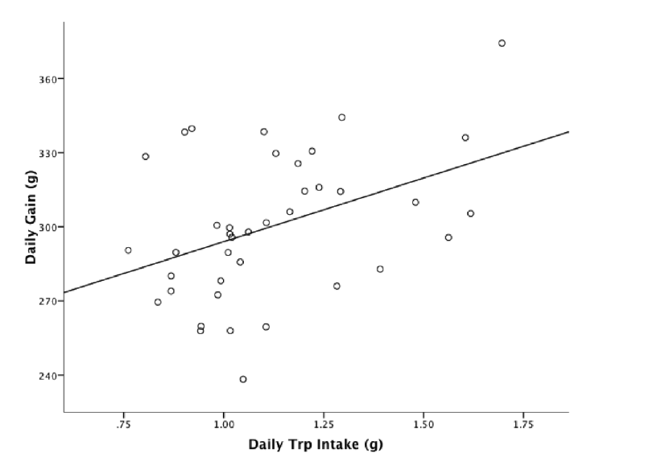
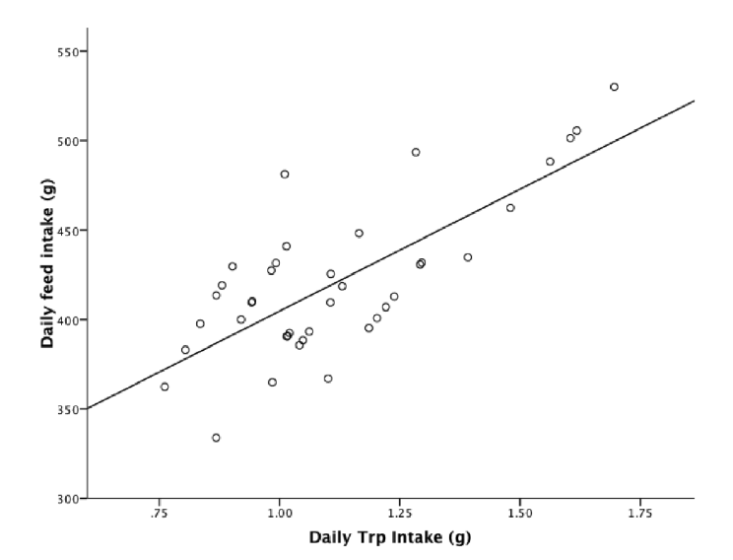
Expressing daily gain and feed intake on a Trp intake basis shows a different result
(y = 242.52 + 51.45x, RSD = 27.07, R² = 0.171, P = 0.009)
(y = 268.38 + 136.33x, RSD = 28.63, R² = 0.563, P < 0.001)
(Capozzalo, 2015; PhD Thesis, Murdoch University)

Slide 18
(Burger et al., 1998)
P < 0.05 (1-way ANOVA)

Slide 19
Main conclusions from this study
Linear improvements in gain and feed intake
Pigs fed Trp:Lys ratio of 0.24 were most efficient
C-reactive protein levels suggested a minimal inflammatory challenge occurred
Despite lack of disease/challenge (no mortality, 2.5% removals),
Data suggests that optimum SID Trp:Lys for production lies above current NRC recommendation of 0.16
In agreement with other studies

Slide 20
Economic model for determining SID Trp:Lys levels in diets (PIC USA)
(http://www.lysine.com/en/tech-info/TrpLys.aspx)

Slide 21
2. Sulphur amino acids

Slide 22
Immune system activation alters amino acid partitioning
Sulphur amino acids (SAA; methionine+cysteine) act as precursors for immune system proteins and metabolites,
Albumin (≈ 11% SAA)
Defensins (≈ 40 % CYS)
Polyamines, choline, carnitine
Glutathione (GSH; ≈ 39 % CYS)
SAA can become deficient when immune system is activated
During immune system activation, SAA are preferentially preserved or repartitioned in favour of non-protein compounds such as glutathione

Slide 23
Sulphur amino acids for weaner pigs
Current NRC recommendations (2012),
7-11 kg BW recommended level of SID SAA:Lys and Met:SAA are 0.56 and 0.51, respectively
11-25 kg BW recommended level of SID SAA:Lys and Met:SAA are 0.55 and 0.52, respectively
Cysteine (Cys) can contribute to 50% of the requirement for Met
Inflammatory conditions after weaning (stress, infection) may generate additional specific requirements for SAA

Slide 24
Aims and Hypotheses
Aim:
Determine optimum SID SAA:Lys ratio in weaner pigs infected with enterotoxigenic E. coli (ETEC)
Hypotheses:
ETEC challenge will increase the requirement for SAA
Pigs fed higher SAA will have better production than those fed lower levels of SAA

Slide 25
Methods
Pigs allocated to the following six treatments (total 120 Topigs pigs) according to:
(i) body weight
(ii) sex (1:1) and
(iii) F4 genotype (RR:RS = 13:7)
Treatment No. | SAA ratios and infection status
1 | 0.45 SID SAA:Lys + Infection
2 | 0.55 SID SAA:Lys + Infection (NRC 2012 level)
3 | 0.62 SID SAA:Lys + Infection
4 | 0.70 SID SAA:Lys + Infection
5 | 0.78 SID SAA:Lys + Infection
6 | 0.55 SID SAA:Lys (No infection) (NRC 2012 level)
[Data for treatments 2 and 6 combined due to both groups succumbing to oedema disease]
Notes:
Diets were formulated with
90% NRC recommended Lys
0.22 SID Trp:Lys
0.64 Thr:Lys

Slide 26
Methods
Day | 0 | 6 | 7 | 8 | 9 | 10 |  | 15 | 20 | 22 |  | 29 |  | 36
Housing | Group housing |  | Individual Housing
Diet* | Phase 1: NE 10.25 MJ/kg, CP 209 g/kg and SID Lys of 11.7 g/kg |  |  |  |  |  |  | Phase 2: NE 10.25 MJ/kg, CP 199 g/kg and SID Lys 10.77 g/kg
Infection** |  |  |  | ✓ | ✓ | ✓
Bleed |  |  |  | ✓ |  | ✓ |  |  | ✓
Diarrhoea Assessment** |  |  | Daily
Weigh | ✓ | ✓ |  |  |  |  |  | ✓ |  | ✓ |  | ✓ |  | ✓
* Standard diet was adjusted with synthetic DL methionine, SID Lys was 90% of NRC 2012 value (restricted), SID Trp:Lys = 0.22 for all diets, SID Thr:Lys = 0.64 for all diets
**Infected with ETEC (5 mL, 1.13 x 108 CFU/mL, serotype O149:K91:K88) on d 8, 9 and 10 after weaning

Slide 27
Faecal consistency score (pre and post-ETEC infection)
Faecal consistency was assessed on a four-point scale with scores;
0 =solid, 1=soft, 2=sloppy, and 3=liquid,
and then converted to percentage values
0=0%, 1=33.33%, 2=66.67%, and 3=100%
(Capozzalo et al., 2014; J. Anim. Sci. 92 (Supplement 2):091)

Slide 28
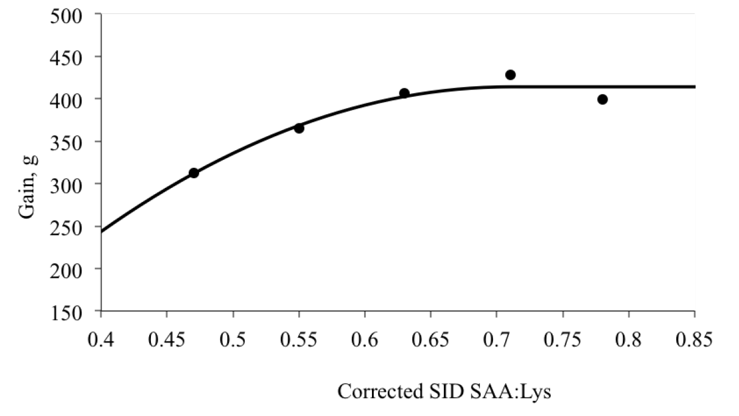
Estimation of optimum SID SAA:Lys level for daily gain in pigs 8-20 kg BW (quadratic broken-line model; R²=0.94)
Current study
NRC (2012)
(Capozzalo, 2015; PhD Thesis, Murdoch University)

Slide 29
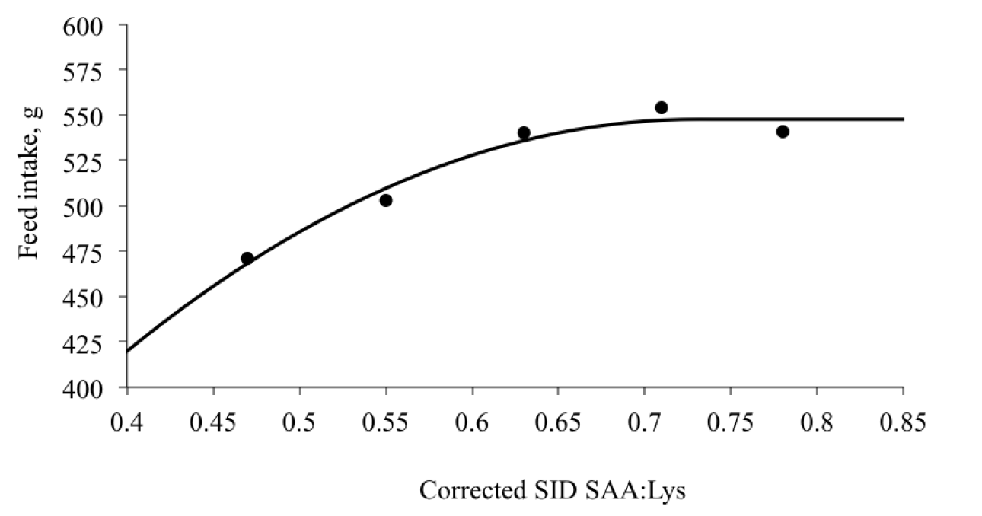
Estimation of optimum SID SAA:Lys level for feed intake in pigs 8-20 kg BW (quadratic broken-line model; R²=0.97)
Current study
NRC (2012)
(Capozzalo, 2015; PhD Thesis, Murdoch University)

Slide 30
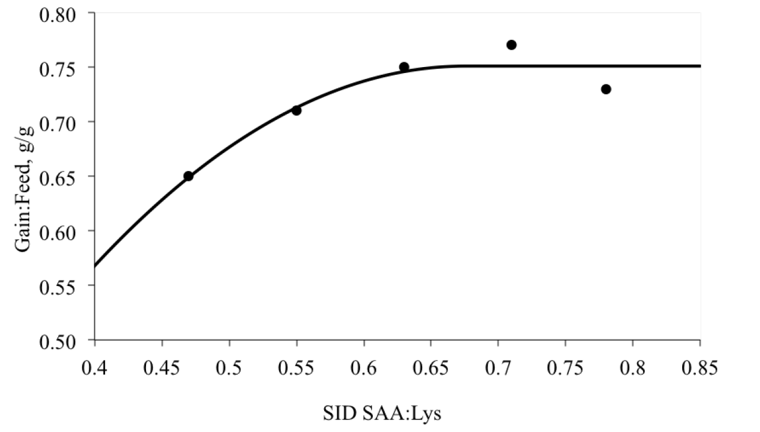
Estimation of optimum SID SAA:Lys level for gain:feed in pigs 8-20 kg BW (quadratic broken-line model; R²=0.90)
Current study
NRC (2012)
(Capozzalo, 2015; PhD Thesis, Murdoch University)

Slide 31
Main conclusions from this study(pigs 8-20 kg BW)
No significant dietary effects of SID SAA:Lys on days with diarrhea (faecal consistency) or shedding of F4 ETEC
Overall daily gain optimised at ≈ 0.71 SID SAA:Lys, while SID SAA:Lys of ≈ 0.73 optimised feed intake
Overall G:F optimised at ≈ 0.68 SID SAA:Lys
Oedema disease kills pigs

Slide 32
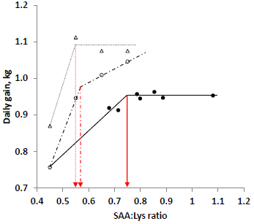
Performance of commercial grow-finish pigs (48-100 kg): daily gain
Experimental studies
Commercial study
(Kim et al., 2015; Anim. Prod. Sci. 55: 1564)
(SAA:Lys ratios of 0.45, 0.50, 0.55, 0.60, 0.65, 0.70, 0.75 and 0.80)

Slide 33
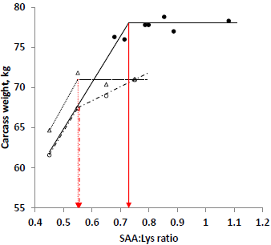
Performance of commercial grow-finish pigs (48-100 kg): carcass weight
Experimental studies
Commercial study
(Kim et al., 2015; Anim. Prod. Sci. 55: 1564)
(SAA:Lys ratios of 0.45, 0.50, 0.55, 0.60, 0.65, 0.70, 0.75 and 0.80)

Slide 34
Overall conclusions
Immunonutrition – feeding (selected) essential/conditionally essential amino acids at targeted times of the production cycle
We, and others, shown that the production optimum for SID Trp and SAA (to Lys) levels in weaner pigs lies above currently recommended levels (e.g., NRC, 2012), even in the absence of disease challenge
Implications for grow-finish pigs
Need to determine the economic optimum

Slide 36
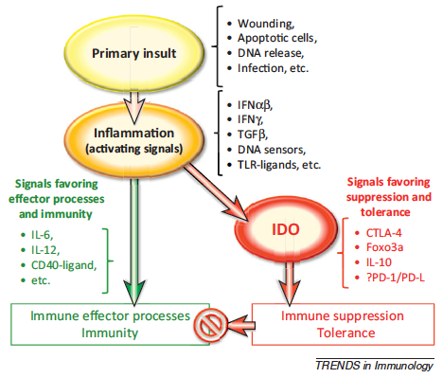
IDO is activated during inflammation and helps create conditions that favor immune suppression and tolerance
(Munn and Mellor, 2013; Trends Immunol. 34: 137-143)
Notes:
Primary insults create local inflammation and
generalized signals that activate immune cells. However, overall immune
outcomes depend on the balance of additional signals that promote either
effector and regulatory responses. Thus inflammation drives the immune
response, but the specific character depends critically on the overall balance of
immune stimulatory and regulatory pathways activated in a particular setting.
Inflammatory signals that favor regulatory/suppressor outcomes often activate
and/or sustain local IDO enzyme activity.

Slide 37
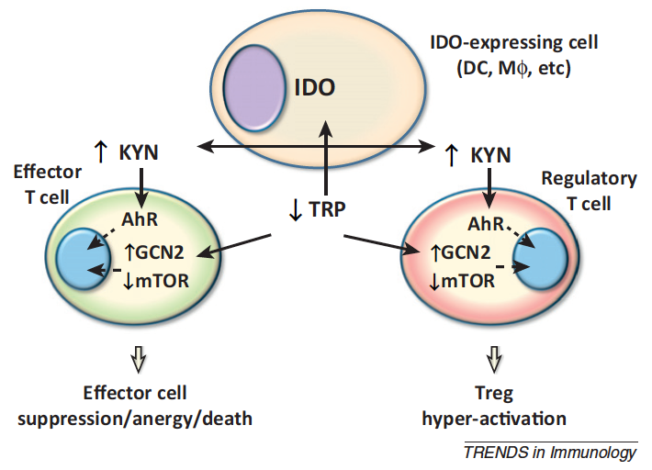
Metabolic control of T cell and Treg responses via IDO
KYN release and TRP consumption
by accessory cells expressing
IDO generates signals
that have profound effects on
T cell and Treg responses
to inflammatory and antigenic
signals
(Munn and Mellor, 2013; Trends Immunol. 34: 137-143)
Notes:
Figure 1. Metabolic control of T cell and Treg responses via IDO. KYN release and
TRP consumption by accessory cells expressing IDO generates signals via AhR and
amino-acid sensors (GCN2, mTOR), respectively, that have profound effects on T
cell and Treg responses to inflammatory and antigenic signals. IDO activity in
APCs also enhances Treg differentiation from naı¨ve CD4 T cells via these metabolic
pathways (not shown).

Slide 38
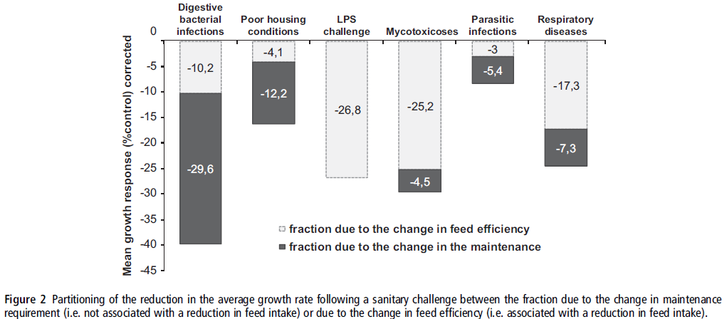
Immune system activation (e.g., through poor sanitation) decreases growth efficiency
(Pastorelli et al., 2012; Animal 6:952–961)

